Slide 1
Pienter: Gamification of
Police Interrogation
P2 – WP3
Human Media Interaction
KLPD / Police Academy

Slide 2
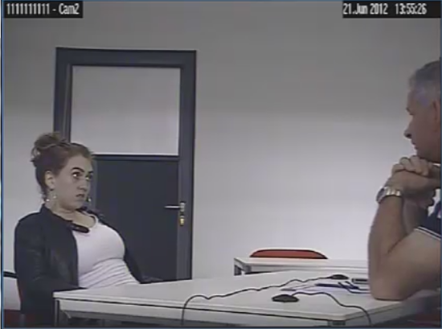
Aims
Build artificial conversational characters that can play the role of a suspect/witness in a police interrogation.
Integrate the artificial suspect in a police interrogation game.
Develop tools for support learning police interrogation.

Slide 3


Slide 4


Slide 5


Slide 6
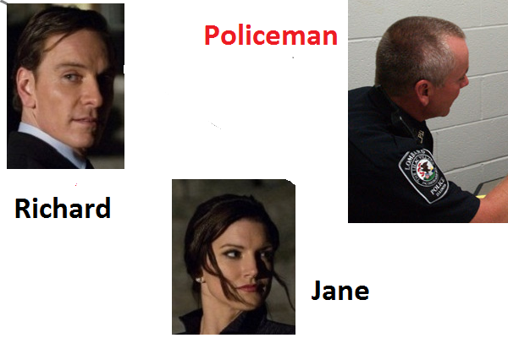

Slide 7
The Scenario
Richard’s wife Susan was found dead in her bathroom on the first of May. Her husband found her at about eight in the evening when he came home from his office. Richard(41) has a succesful investment company.
Injuries found on Susan’s body indicate that her dead might not have been an accident. Was she murdered?
Susan had a visitor that day. Her best friend Jane, a medical assistant.

Slide 8
The Game
Being the police investigator your task is to interrogate Richard and Jane.
Richard (41) and Jane(35) were close friends.
Jane was the first who Richard called after he found his wife.
At least that is what he said when the police arrived at the scene. From Jane we only know that she was indeed with Susan that afternoon.
But we have no information when she left and what she did after she left Susan.

Slide 9
Setting up the Interrogation
On the next page an attempt is made to connect you to Jane the person you will interrogate.
A new frame pops up if a connection is established. The frame allows you to proceed with the interrogation.
You have to choose an interactional stance for each of the contributions you make. Then you type your sentence or whatever you want to express.
The turn is given to the interaction partner as soon as you press ENTER.

Slide 10
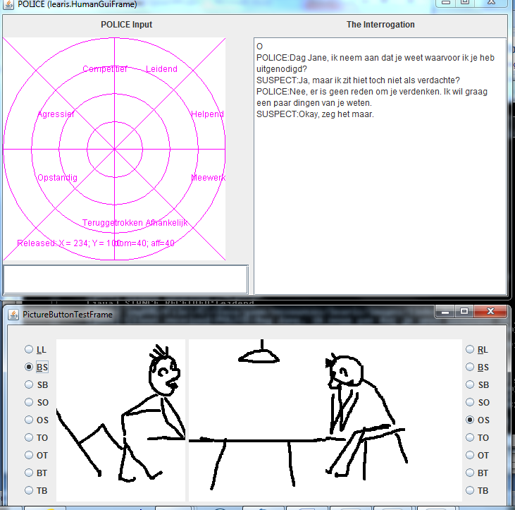

Slide 11
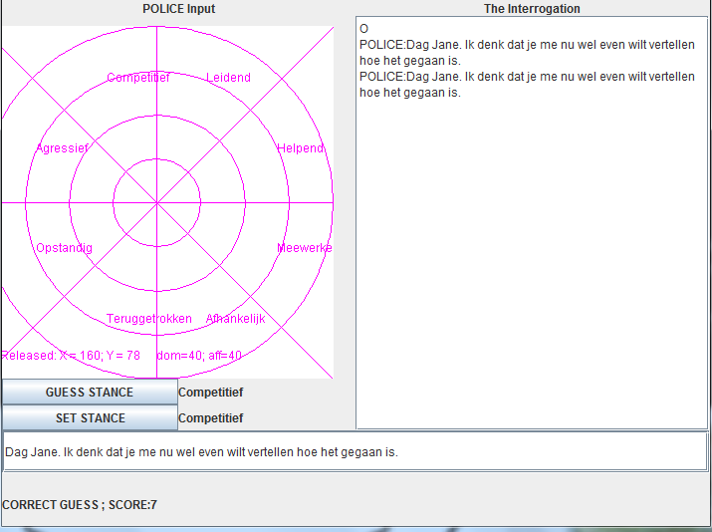

Slide 12
The Game (for Jane)
You have been invited for an interrogation at the police office.
Richard (41) and you(35) were close friends and Richard called you that evening after he found his wife.
You were with with Susan that afternoon and left her at about 5 pm. Susan had told you that she would go to the opera that evening. You returned to Richard’s and Susan’s home at about 7 pm. Then you found Susan dead. You decided to leave the place immediately. When you were on your way home Richard called you to tell the terrible news. You don’t have any idea what happened. But you have your thoughts…

Slide 13
Setting up the Interrogation
On the next page an attempt is made to connect you to the Police Investigator.
A new frame pops up if a connection is established. The frame allows you to proceed with the interrogation.
You have to choose an interactional stance for each of the contributions you make. Then you type the text you want to communicate. The turn is given to the interaction partner as soon as you press ENTER.

