Slide 1
Guide into low-level systems programming
by Istvan Haller

Slide 2
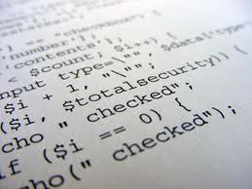
Why are we here?
What is a variable?
How does “print” work?
How can hackers confuse software?

Slide 3
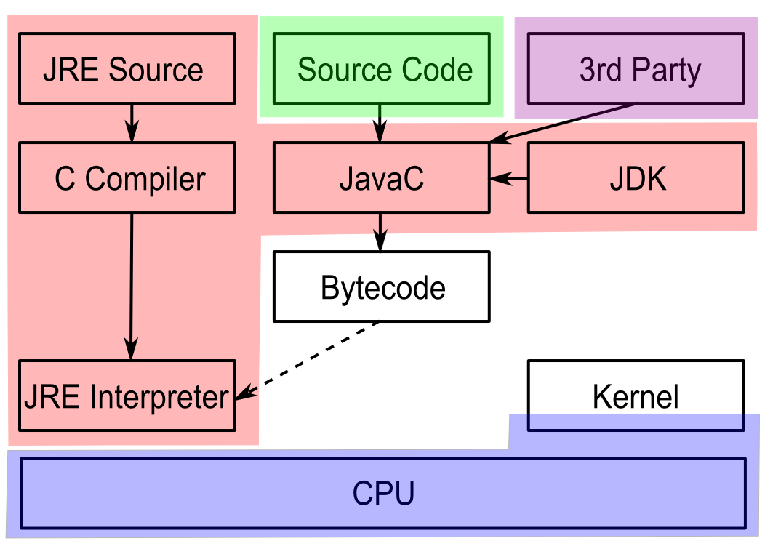
Here is where the magic happens!

Slide 4
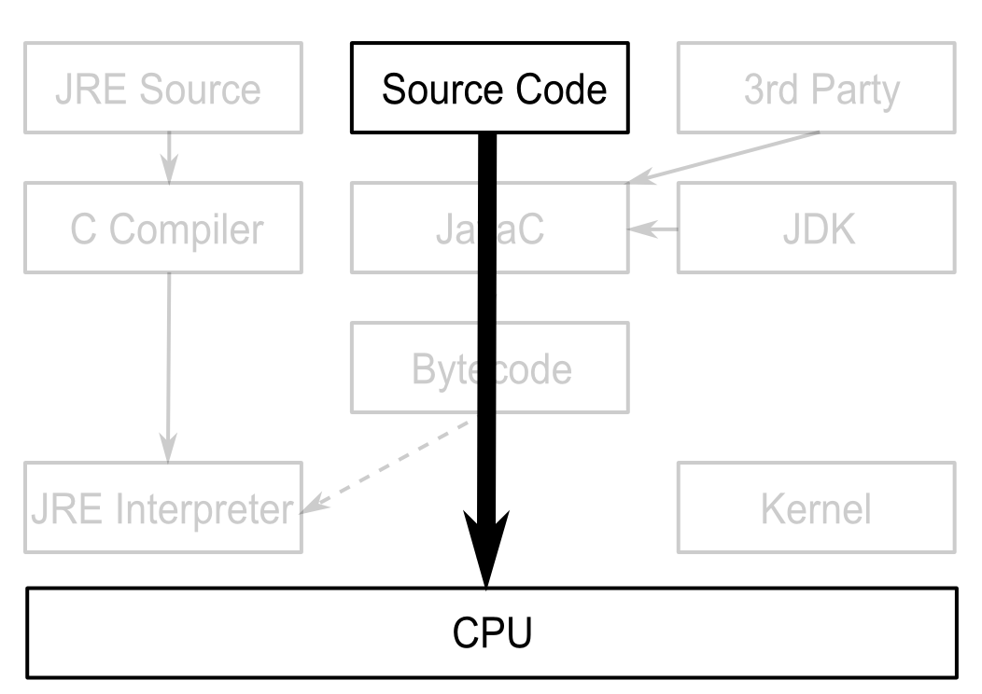
Understanding our system

Slide 5
Can't I just program Java/Python?
Pros
Benefits productivity
Cons
Transparency versus manual control
Limited to sandbox
Poor understanding of underlying principles
Know when to use different languages

Slide 6
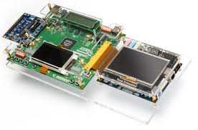
Low-level programming in practice
Computer Security
Operating System Design
Embedded Systems

Slide 7
Hackers lurk in the shadows
Attacks exploit unexpected software behavior
Malicious code running besides user code is visible
Malware designer understands system-level concepts to facilitate evasion
Rootkits go beneath the OS, taking full control

Slide 8
SMM based rootkits
System management mode on Intel CPUs
Intended for hardware management
Complete stealth from regular system
Activated by intercepting system events
"SMM Rootkits: A New Breed of OS Independent Malware"

Slide 9
Black-hat vs White-hat
Cannot defend what you don’t understand
Vulnerabilities are everywhere (even Java)
Pre-emptive hacking can discover vulnerabilities
Wide range of penetration testing companies

Slide 10
Systems don't grow on trees
Somebody has to design the OS and compiler
Custom compiler design enabled by LLVM
Many-cores need new paradigms in OS design
Will you be part of the leading edge?

Slide 11
Minix
A number of current research topics
Live updates
Apply software patches on the fly
Many-core operating system
Distributed drivers and software stacks
Fault tolerance and security
User-space drivers

Slide 12
Developments from the Big Guys
Android
iOS
Google Chrome OS
Amazon Silk
Continuous development on Linux Kernel
Check-pointing, Live patching

Slide 13
Embedded systems are cool (again)
What drives your microwave, washing machine?
Simple 8 / 16 bit processors still ubiquitous
Prevalence of battery powered devices
Pacemakers, wireless sensors
The Arduino trend among hobbyists
32bit but < 640KB RAM
Fun projects
Can you code with such limitations?

Slide 14
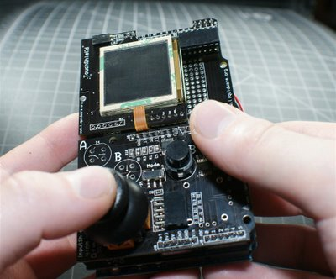
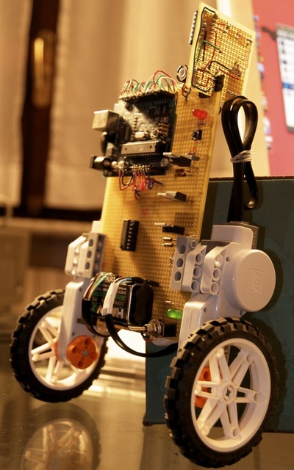
Arduino projects on the web
Laser harp
Open-source GameBoy
Autonomous robots
Many more at your fingertips...

Slide 15
Options for getting started
Arduino board and online documentation
Custom board design + course material
AVR ATMega, MicroChip PIC, TI MSP430
Raspberry PI for embedded systems?
Under development (I have some ideas ☺)
Blinking LED → Playing with first sensors
→Line following robot

Slide 16
Low-level details in regular code
Arithmetic quirks
The wonders of binary representation
Network language barrier
“Standards” for data organization
???
Understanding programming rules from the perspective of the hardware

Slide 17
Arithmetic games
int data type: to
Why not symmetrical?
What is the value of B in the following?
A = ;
if (A >= 0)
B = A;
else
B = -A;

Slide 18
Representing signed values
Sign + Value
Sign: 1 bit, 0 → positive, 1 → negative
Value: remaining 31 bits
Symmetric: to (also )
What about subtraction:
Special arithmetic for subtraction

Slide 19
Representing signed values (cont.)
2’s Complement
Sign: 1 bit, 0 → positive, 1 → negative
Value: from all 32 bits
Asymmetric: to (no )
Alternative computation:

Slide 20
Networking in Linux
The htonl() function converts the unsigned integer hostlong from host byte order to network byte order.
The ntohl() function converts the unsigned integer netlong from network byte order to host byte order.
From Linux man pages
But why do we talk abut byte order?

Slide 21
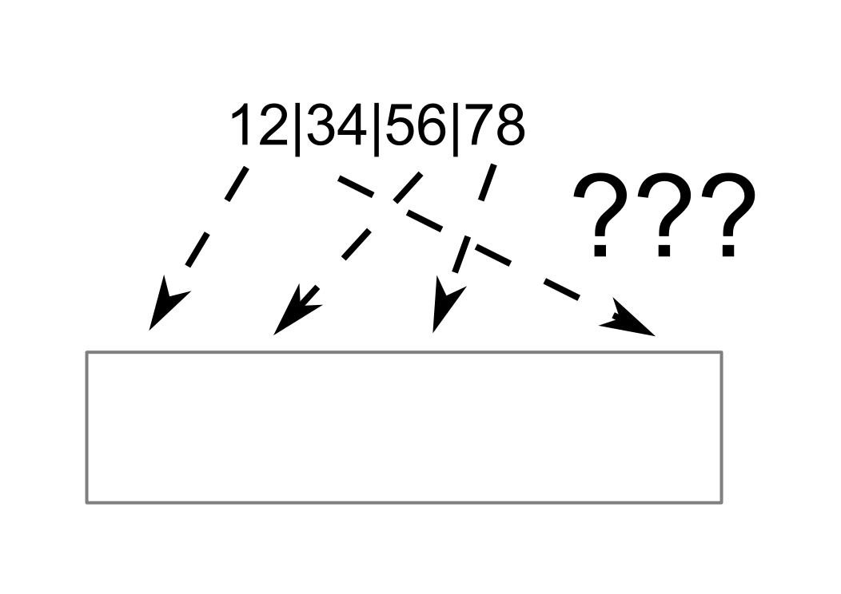
Byte order in memory
Take an arbitrary 4-byte integer: 0x12345678
Now put it into memory
Each manufacturer has different “standard”
Network equipment also expects given order

Slide 22
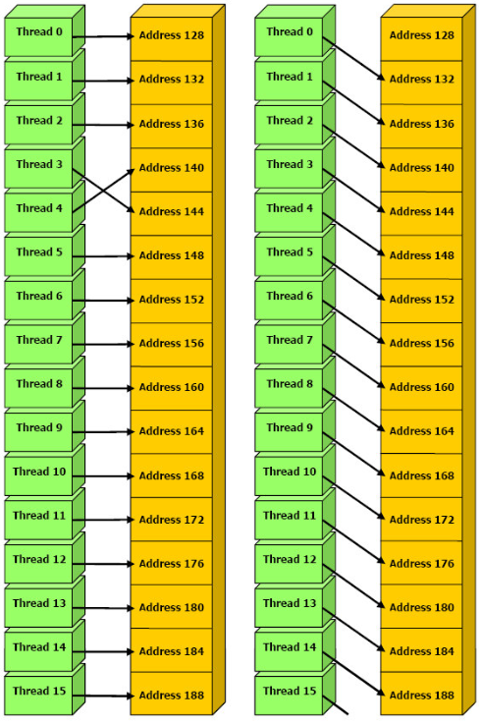
GPUs and memory coalescing

Slide 23
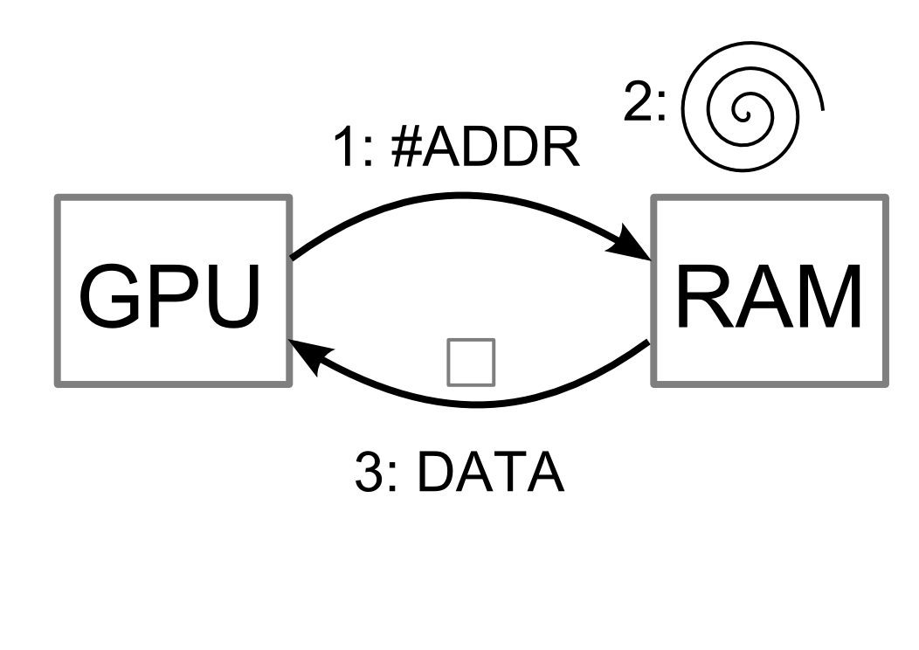
Short history about DRAM
DRAM → Dynamic RAM → ”Volatile”
Requires periodic refresh to maintain storage
Refresh triggered by memory access
→Accessing given memory location slow

Slide 24
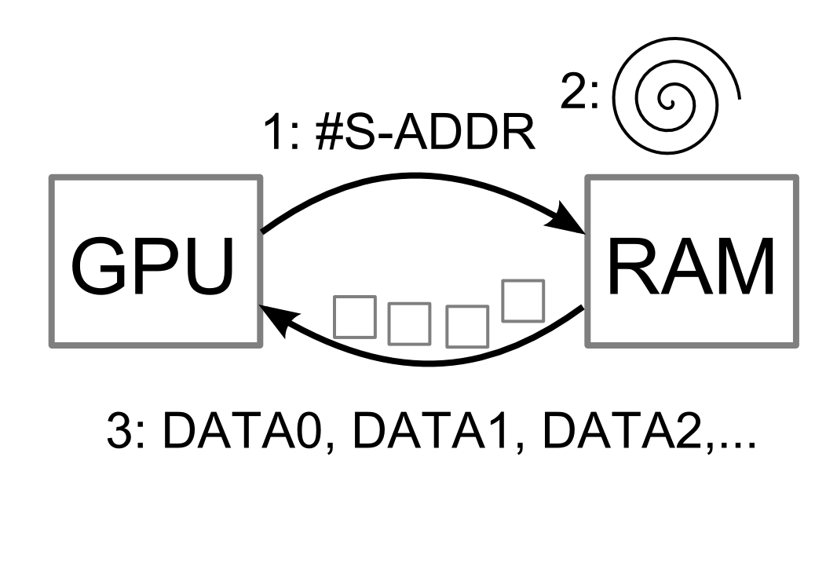
Better use of DRAM
Why limit to single data?
Almost free to access nearby locations
Burst mode: transfer chunk to consecutive data
Start address typically aligned

Slide 25
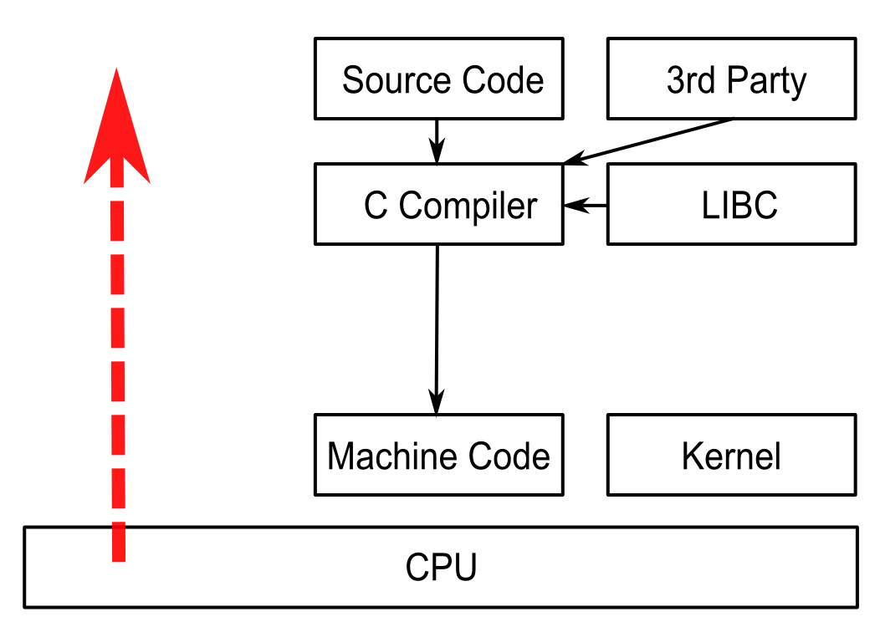
Scope of the course
Understanding the system bottom-up

Slide 26
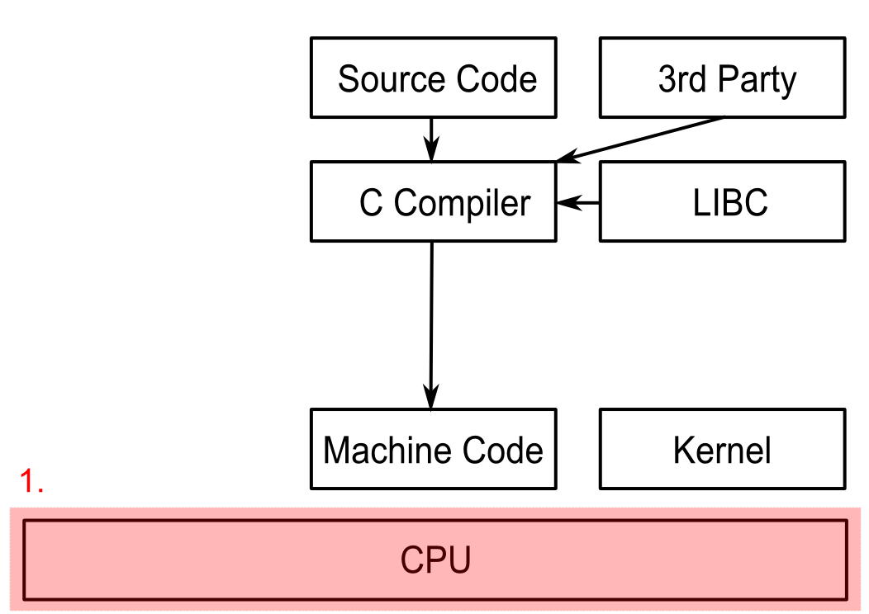
Intro to computer architectures
Learning the underlying hardware concepts and design decisions

Slide 27
Questions to be answered
What are the basic building blocks of a CPU?
How is data organized in memory?
What happens at a conditional statement?
How are function calls managed?

Slide 28
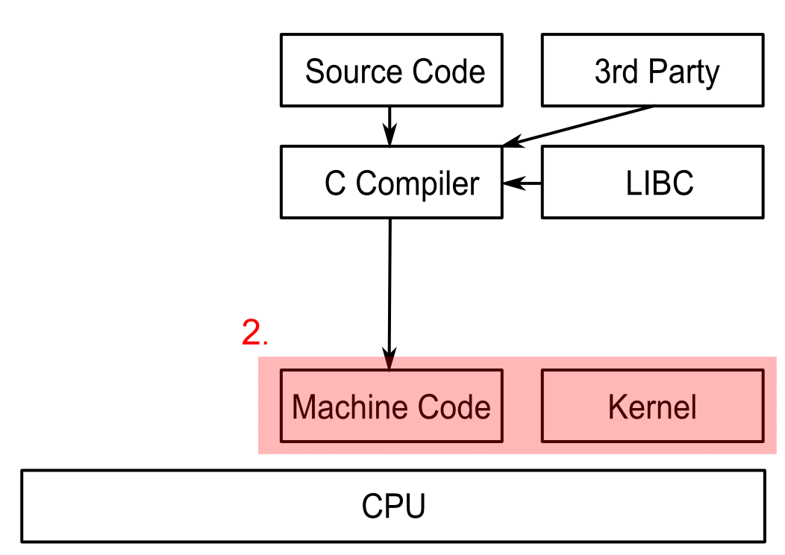
Crash course in machine code
Programming the processor itself
X86 as running example

Slide 29
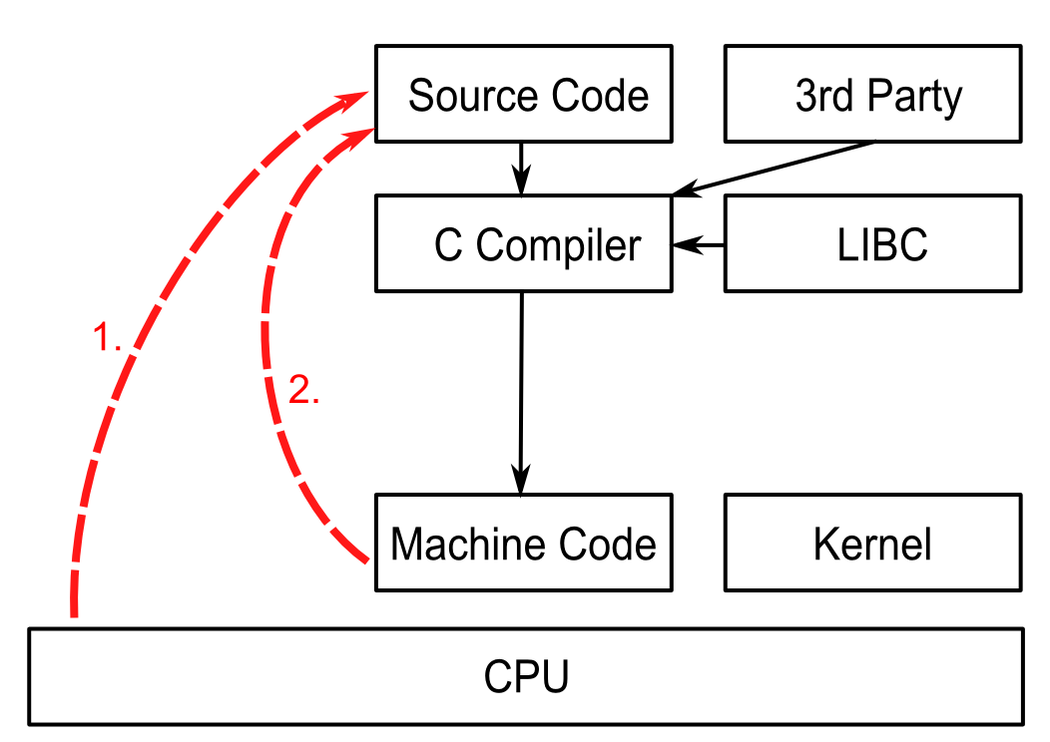
Correlations with source code
Illustrate source code concepts in practice
Examples of C code snippets and their effect

Slide 30
Practice makes perfect
Combining the concepts to interact with X86 hardware components (drivers)
Learn about timers, interrupts, output ports
Develop under minimalistic modern system
Example project presented in class
Mini-project ideas

Slide 31
Course plan
Programmer's view on Computer Architecture (1)
“Computer Organization and Design: The Hardware/Software Interface”
by David A. Patterson and John L. Hennessy
Introduction to X86 assembly language (2)
Advanced topics in X86 assembly (3)
“The Art of Assembly Language Programming”
by Randall Hyde
Programming system code (4)
Interacting with X86 hardware devices (5)
http://wiki.osdev.org

