Slide 1
Programmer's view on Computer Architecture
by Istvan Haller

Slide 2
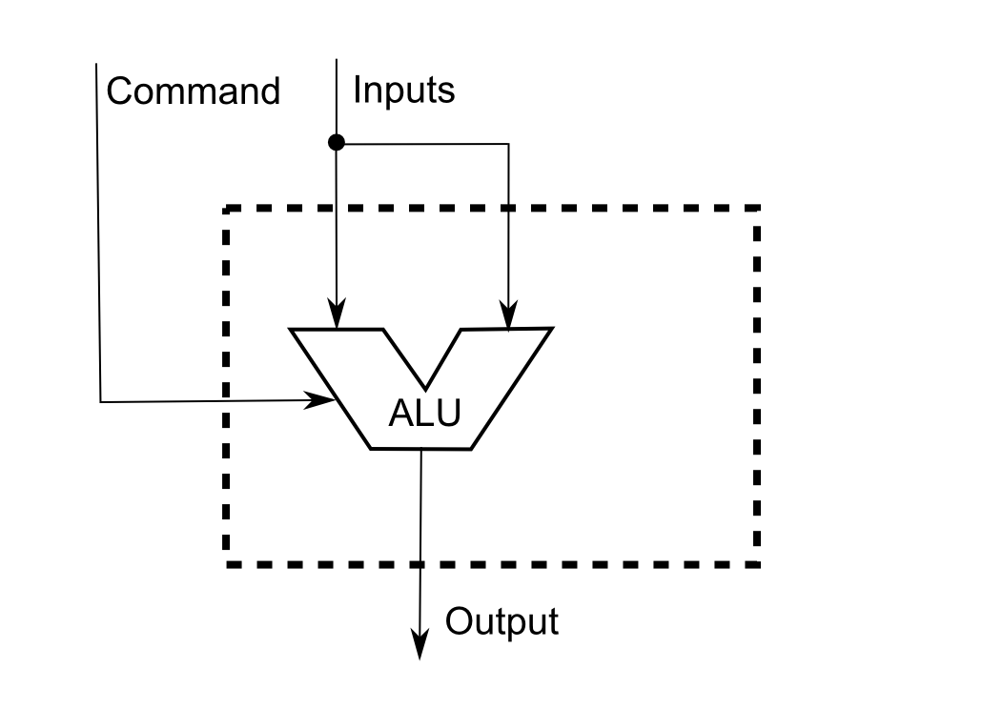
Basic purpose of a processor (CPU)
Perform computations between data

Slide 3
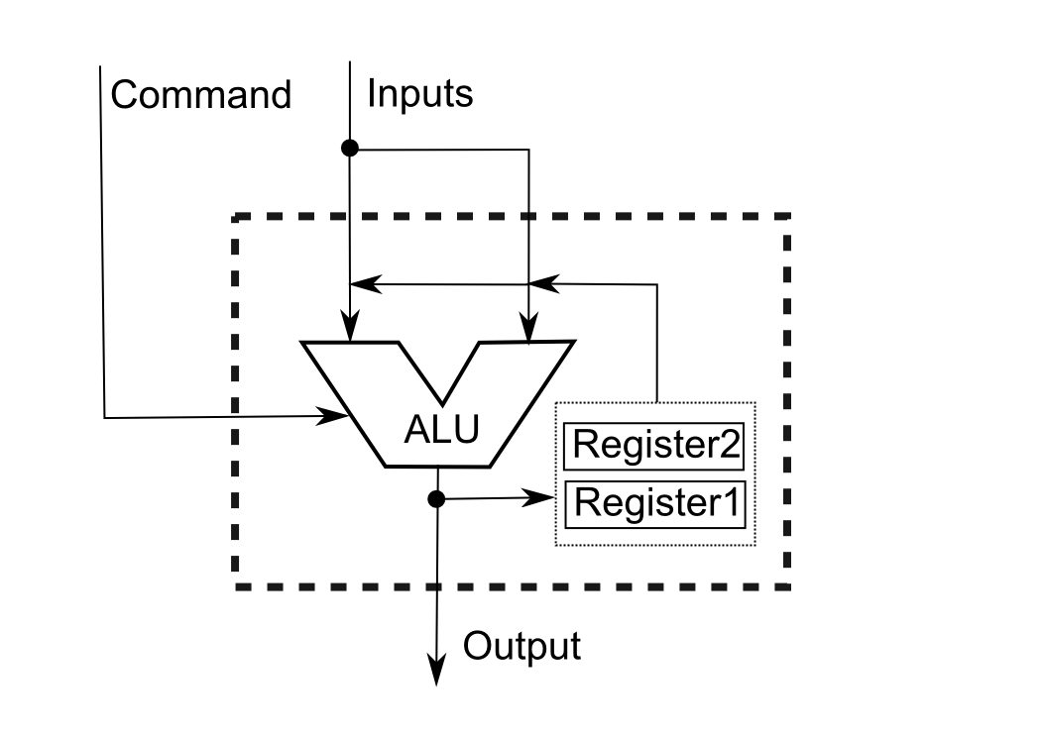
Addition of a feed-back loop
Temporary storage to reuse computations

Slide 4
Registers
Registers allow reuse of computations
Efficiency ↔ Keep data on processor
Uniquely addressable by name
Multiple types
General purpose: managed explicitly by program
Special purpose: implicit usage
Some can be accesses explicitly as-well

Slide 5
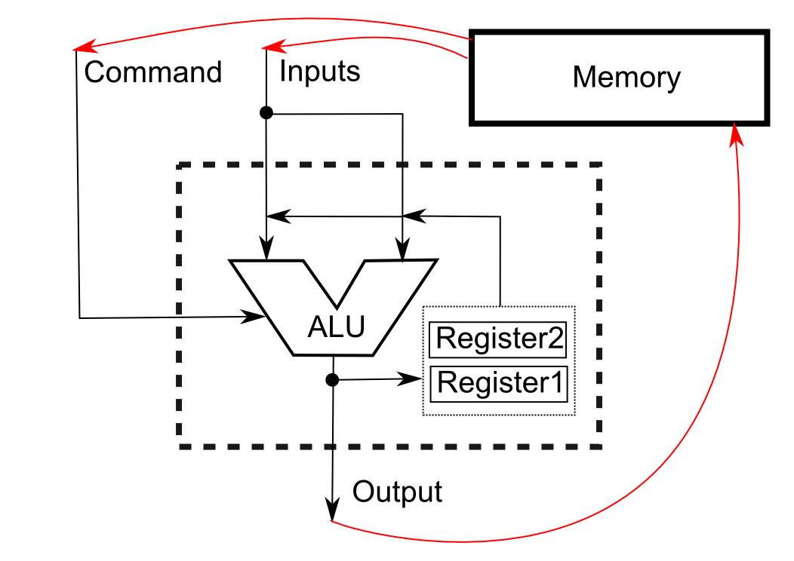
Set up and forget → Memory
Minimize user interaction through storage

Slide 6
Content of memory
Commands to be executed (instructions)
Input data ← What does the application need?
Output data ← Final result of computations
Temporary data ← Registers are limited

Slide 7
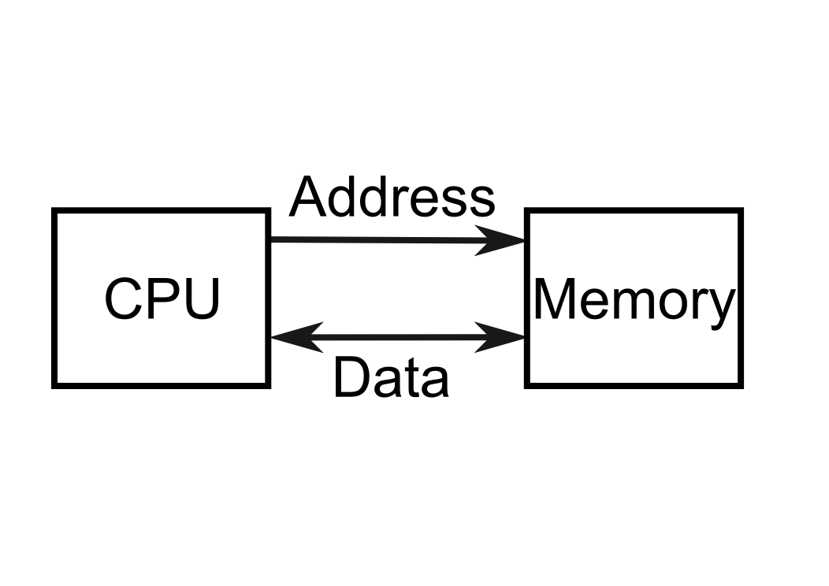
Accessing memory
Memory is contiguous string of bytes
No structure!!!
Structure is defined through usage
Access based on address ← Offset in memory
Can be both read or written

Slide 8
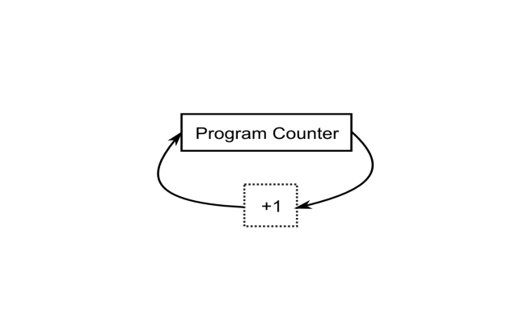
Instructions in memory
Components of an instruction:
Command to be executed
Registers to be used
Numeric constants (including memory addresses)
Instructions executed in sequence
Address generated by Program Counter

Slide 9
Accessing data in memory
2 main addressing modes
Direct addressing
Supply the concrete address in memory
int var1;
reg1 = load_from (&var1)
Indirect addressing
Use running computation from register as address
reg1 = &var1 + 10
reg2 = load_from (reg1)

Slide 10
Issues with memory
Can only serve a single request at a time
Requirements to process instruction:
Read instruction from memory (always)
Read/write any memory operands (typically)
Limit number of memory operands
X86: maximum 1 memory operand
Simple processors (ARM): no memory operands
Special memory manipulation instructions: load, store

Slide 11
Memory organization: Harvard
Simplest design, inefficient memory usage

Slide 12
Memory organization: Neumann
Traditional design, contention for memory

Slide 13
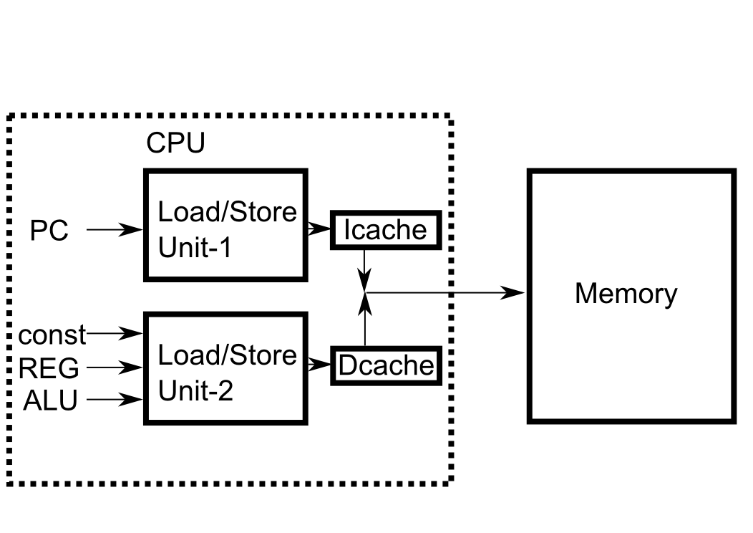
Memory organization: current
Single memory, but separation of access

Slide 14
Changing the program flow
Until now we considered sequential order
What happens for the following construction?
if (cond)
codeA;
else
codeB;
PC needs to change based on conditional
New sources for PC value

Slide 15
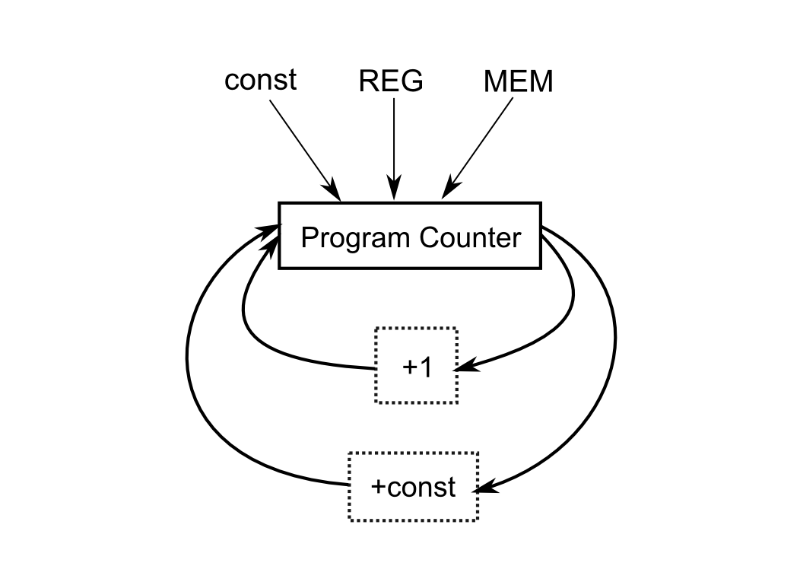
Influences on Program Counter
Jumping: non-sequential change in PC
Relative jump ↔ Skip block of code
Absolute jump ↔ Go to specific line of code

Slide 16
Conditionals
Evaluate conditional → Change program flow
if (a < b)
Components:
Operands “a” and “b”
Operation “<”
Jump targets (what should happen with PC)
Too much for single instruction

Slide 17
Evaluator vs Conditional Jump
Separate evaluation from program flow
Evaluator: instruction that compares operands
Similar to arithmetic and logic instructions
Result is binary flag (True/False)
Propagate result to conditional jump
Change program flow based on state of flag
Compare(“<”, a, b)→Flag Register→Flag ? Target1 : Target2

Slide 18
Conditional jump
Two targets too much for single instruction
Implicit target is next instruction
Fall-through edge
Pseudo-code interpretation
if (cond)
goto explicit_target;
implicit_target:
…
explicit_target:

Slide 19
Restructuring conditional code

Slide 20
Restructuring conditional code

Slide 21
Restructuring conditional code

Slide 22
Restructuring conditional code

Slide 23
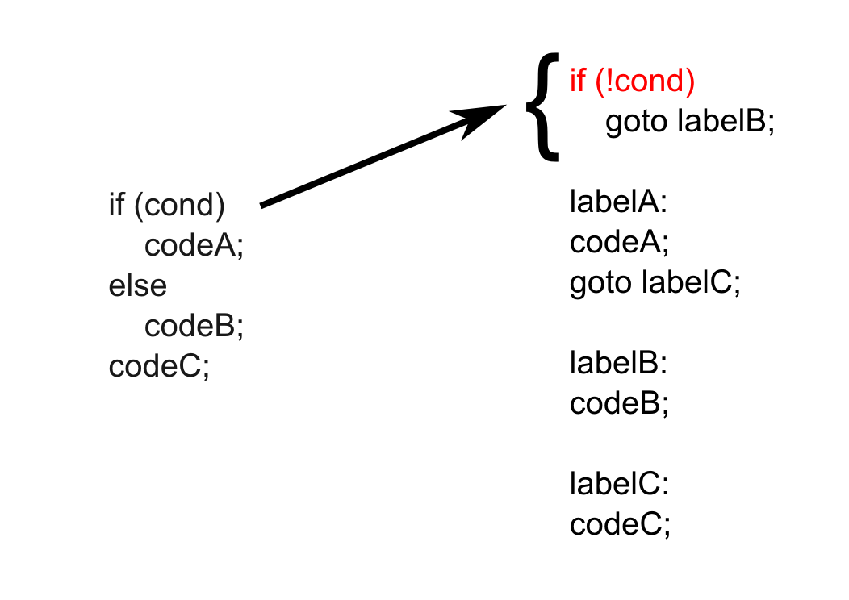
Restructuring conditional code

Slide 24
Supporting function calls
What is a function call?
Start executing function code↔Jump to function
Return to caller location↔Jump back to call site
But where was the function called from?
Store return address when calling function
Multiple functions in program!
Function may be called multiple times (re-entrant)!
Need for designated storage

Slide 25
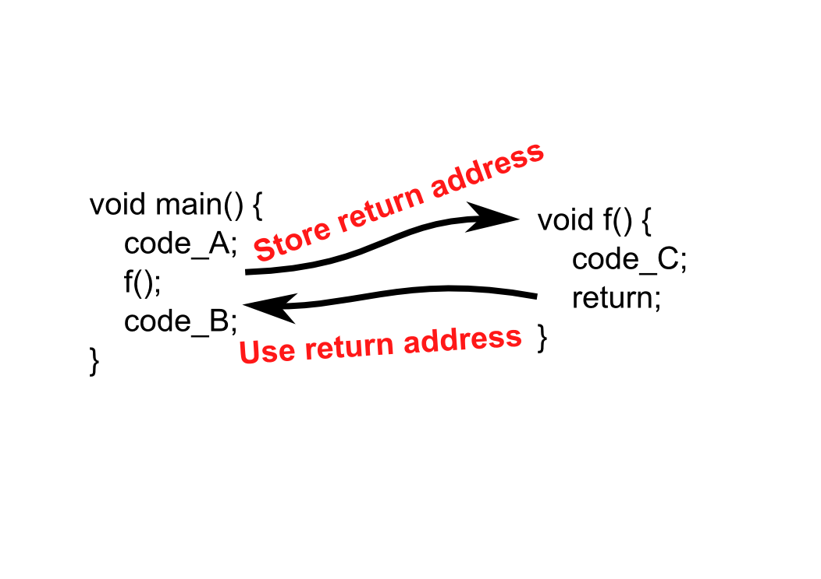
Function call in a nut-shell

Slide 26
Managing the return address

Slide 27
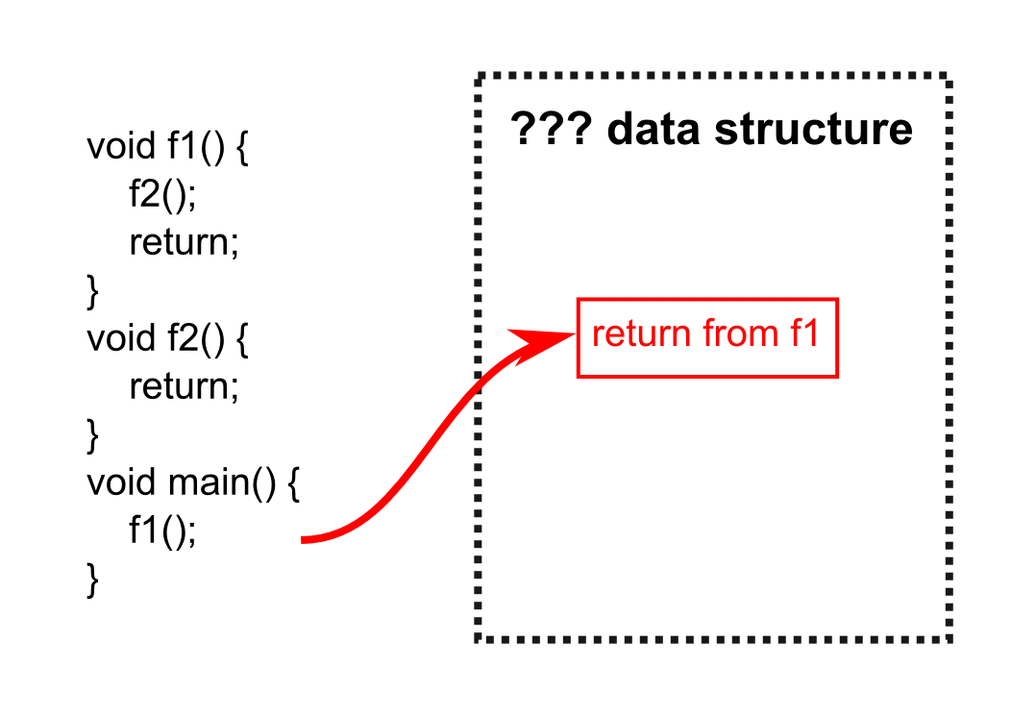
Managing the return address

Slide 28
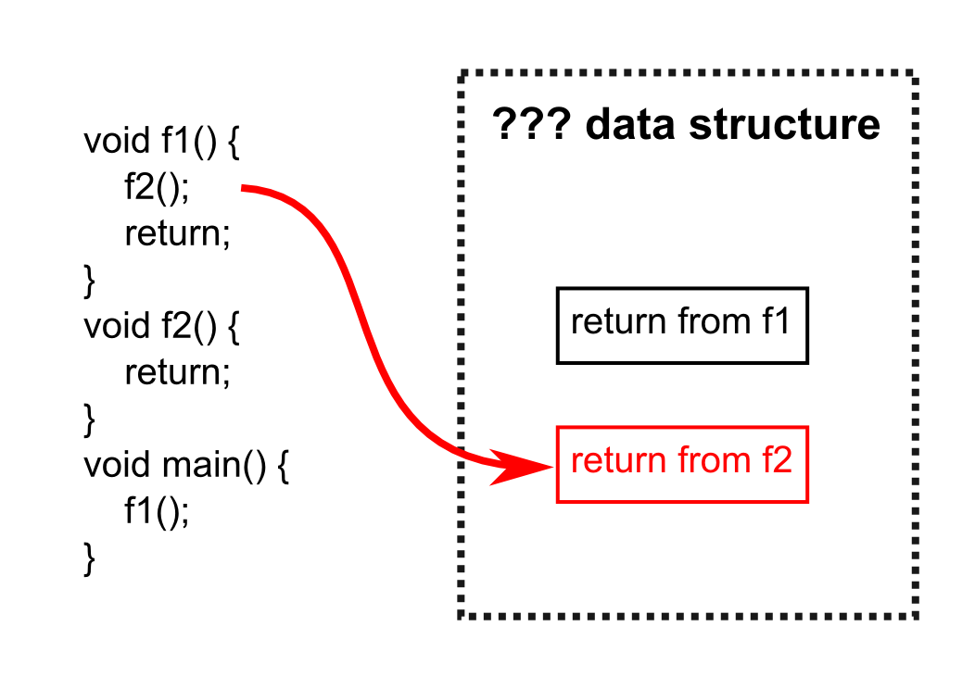
Managing the return address

Slide 29
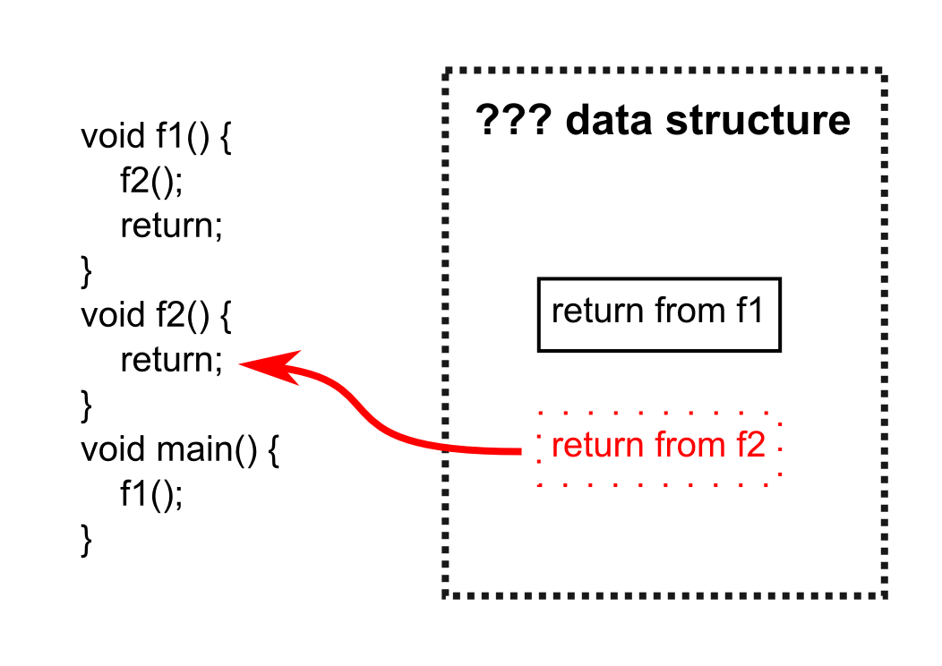
Managing the return address

Slide 30
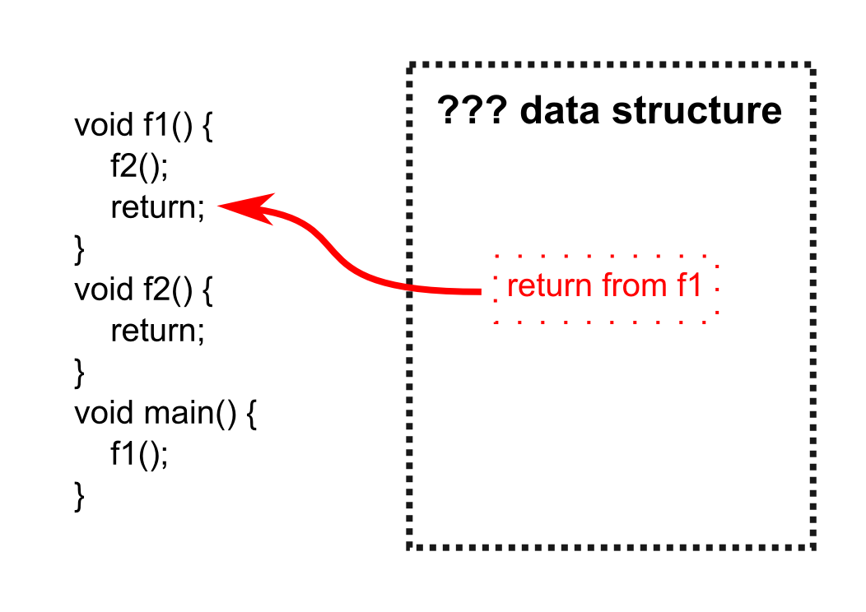
Managing the return address

Slide 31
The stack!
Last return address stored used by first return
Last In – First Out ↔ Stack
Stack Requirements:
Contiguous sequence of memory
Stack Pointer ← Special Purpose Register

Slide 32
Other function related concepts
Function arguments
Unique for every instance of the function call
Passed in registers?
Possible if no other functions called
Otherwise registers need to be saved (where?)
Typically passed on the stack
Instance specific storage as with return address
No limit on argument count (variable length possible)

Slide 33
Other function related concepts
Function local variables
Similar to function arguments
Unique for every instance of the function call
Temporary storage of registers
Function execution may be interrupted
Need to save registers in the function context
Use the stack as “unlimited” storage

Slide 34
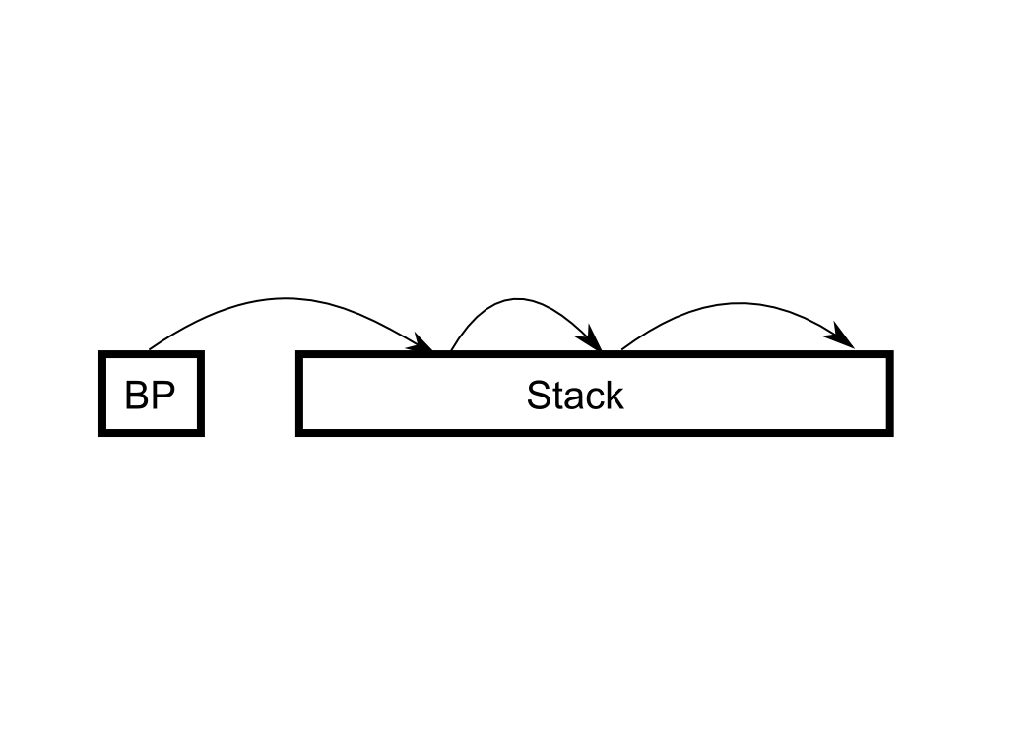
Function frames
Elements related to given function instance
Arguments, return address, locals, temporaries
Stack pointer volatile inside function
How to find beginning of function frame?
Base Pointer Register
What about the previous function?
Store chain of base pointers on stack

