Slide 1
Introduction to X86 assembly
by Istvan Haller

Slide 2
Assembly syntax: AT&T vs Intel
MOV Reg1, Reg2
What is going on here?
Which is source, which is destination?

Slide 3
Identifying syntax
Intel: MOV dest, src
AT&T: MOV src, dest
How to find out by yourself?
  Search for constants, read-only elements (arguments on the stack), match them as source
IdaPro, Windows uses Intel syntax
objdump and Unix systems prefer AT&T

Slide 4
Numerical representation
Binary (0, 1): 10011100
  Prefix: 0b10011100 ← Unix (both Intel and AT&T)
  Suffix: 10011100b ← Traditional Intel syntax
Hexadecimal (0 … F): “0x” vs “h”
  Prefix: 0xABCD1234 ← Easy to notice
  Suffix: ABCD1234h ← Is it a number or a literal?

Slide 5
Which syntax to use?
Don’t get stuck on any syntax, adapt
Quickly identify syntax from existing code
Every assembler has unique syntactic sugaring
Practice makes perfect
These lectures assume traditional Intel syntax
  IdaPro (BAMA) + NASM (Mini-project)

Slide 6
Traditional Registers in X86
General Purpose Registers
  AX, BX, CX, DX
Pseudo General Purpose Registers
  Stack: SP (stack pointer), BP (base pointer)
  Strings: SI (source index), DI (destination index)
Special Purpose Registers
  IP (instruction pointer) and EFLAGS

Slide 7
GPR usage
Legacy structure: 16 bits
  8 bit components: low and high bytes
  Allow quick shifting and type enforcement
AX ← Accumulator (arithmetic)
BX ← Base (memory addressing)
CX ← Counter (loops)
DX ← Data (data manipulation)

Slide 8
Modern extensions
“E” prefix for 32 bit variants → EAX, ESP
“R” prefix for 64 bit variants → RAX, RSP
Additional GPRs in 64 bit: R8 →R15

Slide 9
Endianness
Memory representation of multi-byte integers
For example the integer: 0A0B0C0Dh (hexa)
Big-endian↔highest order byte first
  0A 0B 0C 0D
Little-endian↔lowest order byte first (X86)
  0D 0C 0B 0A
Important when manually interpreting memory

Slide 10
Endianness in pictures

Slide 11
Operands in X86
Register: MOV EAX, EBX
  Copy content from one register to another
Immediate: MOV EAX, 10h
  Copy constant to register
Memory: different addressing modes
  Typically at most one memory operand
  Complex address computation supported

Slide 12
Addressing modes
Direct: MOV EAX, [10h]
  Copy value located at address 10h
Indirect: MOV EAX, [EBX]
  Copy value pointed to by register BX
Indexed: MOV AL, [EBX + ECX * 4 + 10h]
  Copy value from array (BX[4 * CX + 0x10])
Pointers can be associated to type
  MOV AL, byte ptr [BX]

Slide 13
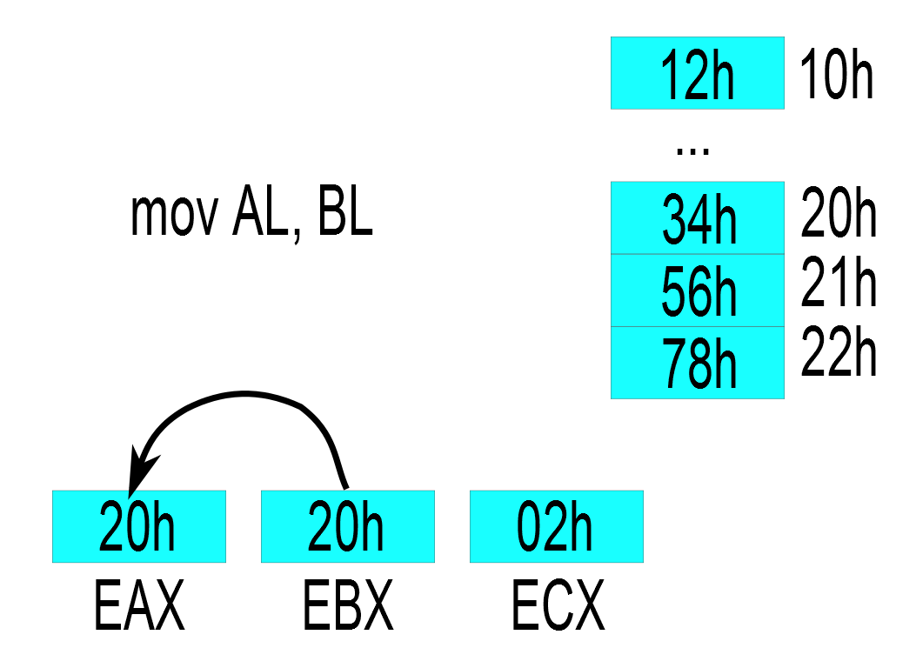
Operands and addressing modes:
Register

Slide 14
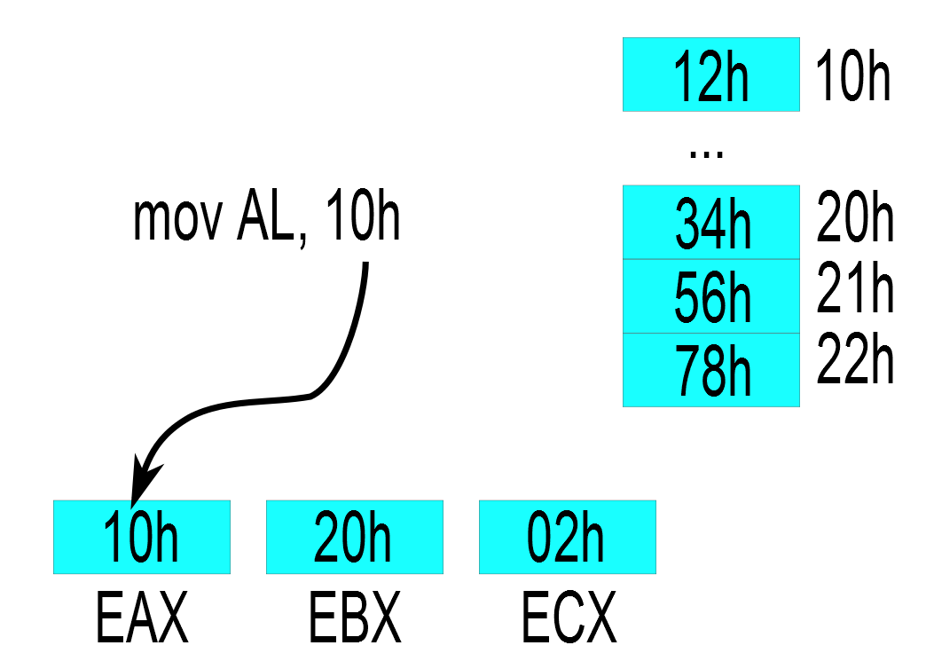
Operands and addressing modes:
Immediate

Slide 15
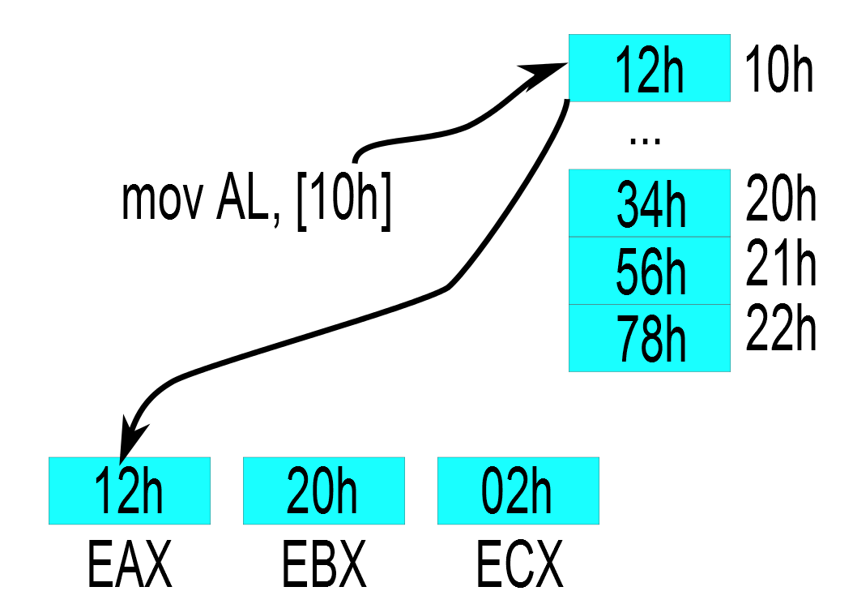
Operands and addressing modes:
Direct

Slide 16
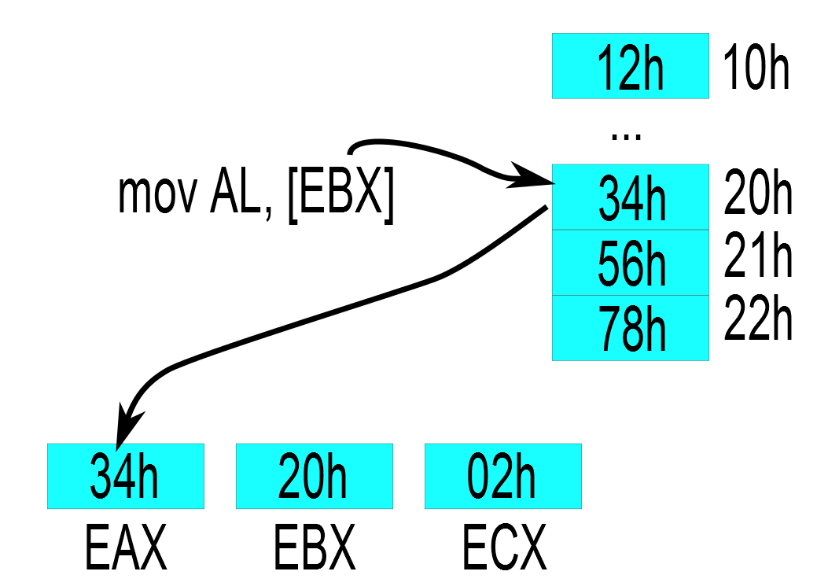
Operands and addressing modes:
Indirect

Slide 17
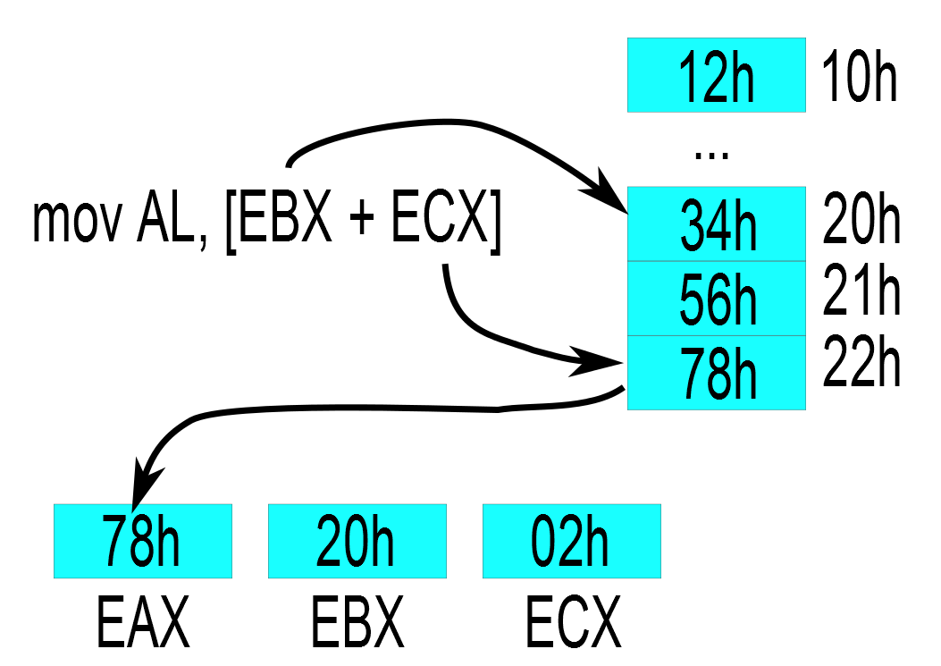
Operands and addressing modes:
Indexed

Slide 18
Data movement in assembly
Basic instruction: MOV (from src to dst)
Alternatives
  XCHG: Exchange values between src and dst
  PUSH: Store src to stack
  POP: Retrieve top of stack to dst
  LEA: Same as MOV but does not dereference
    Used to computer addresses
    LEA EAX, [EBX + 10h] ↔ MOV EAX, EBX + 10h

Slide 19
Stack management
PUSH, POP manipulate top of stack
  Operate on architecture words (4 bytes for 32 bit)
Stack Pointer can be freely manipulated
Stack can also be accessed by MOV
The stack grows “downwards”
  Example: 0xc0000000 → 0

Slide 20
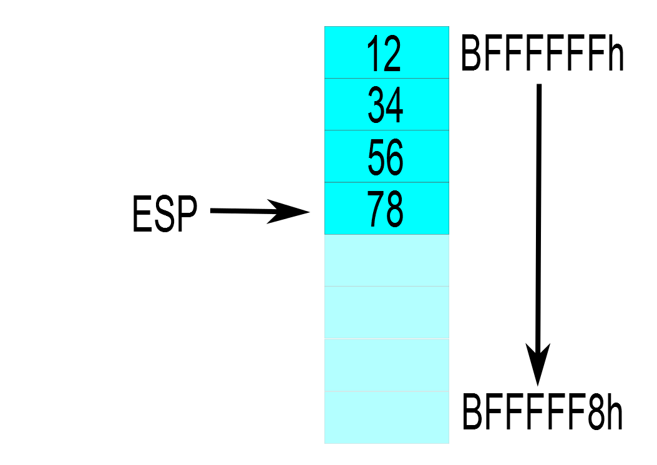
Manipulating the top of stack

Slide 21
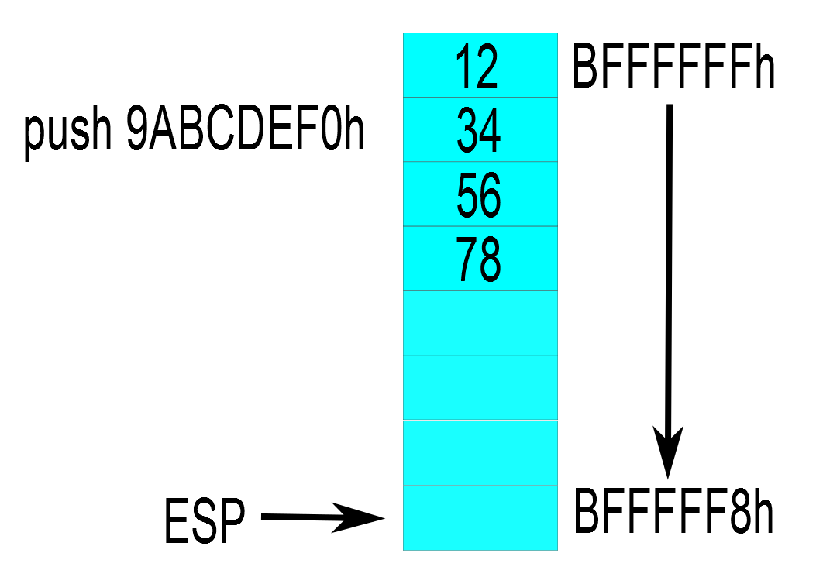
Manipulating the top of stack

Slide 22
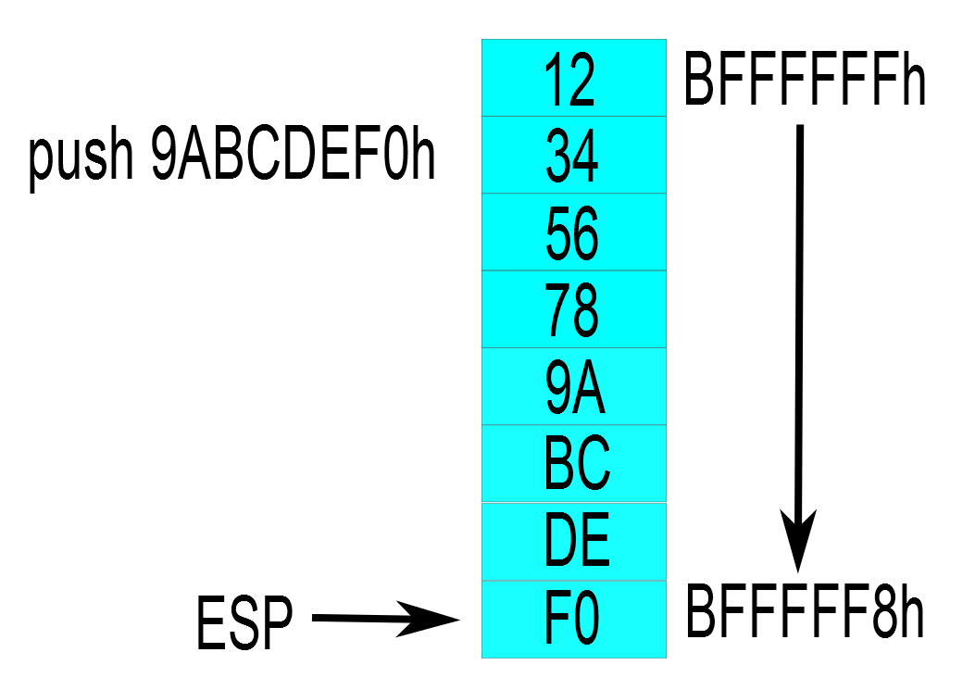
Manipulating the top of stack

Slide 23
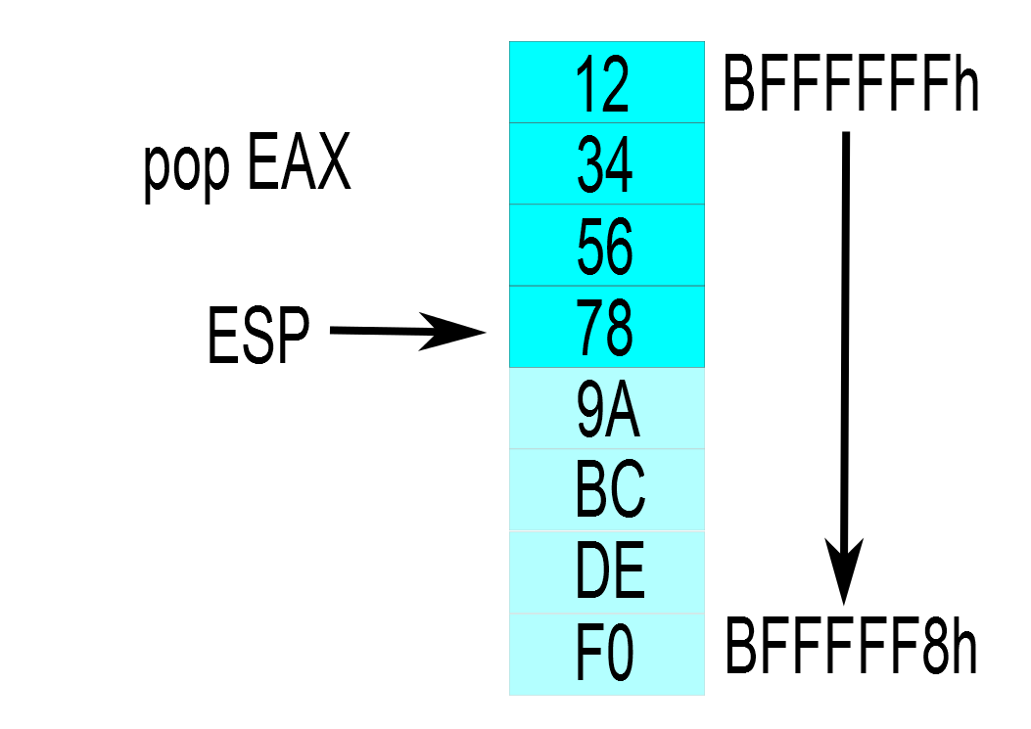
Manipulating the top of stack

Slide 24
Arithmetic and logic operations
ADD, SUB, AND, OR, XOR, …
MUL and DIV require specific registers
Shifting takes many forms:
  Arithmetic shift right preserves sign
  Logic shifting inserts 0s to front
  Rotate can also include carry bit (RCL, RCR)
Shift, rotate and XOR tell-tale signs of crypto

Slide 25
Conditional statements
Two interacting instruction classes
Evaluators: evaluate the conditional expression generating a set of boolean flags
Conditional jumps: change the control flow based on boolean flags
Expression → Evaluator → EFLAGS → Jump

Slide 26
Conditional statements - Evaluators
TEST - logical AND between arguments
  Does not perform operation itself, focus on Zero Flag
  Detecting 0: TEST EAX, EAX
  State of a bit: TEST AL, 00010000b (mask)
CMP – logical SUB between arguments
  Compare two values: CMP EAX, EBX
  Focus on Sign, Overflow and Zero Flags
All arithmetics influence flags

Slide 27
Conditional statements - Jumps
Conditional jumps based on status of flags
Conditional jumps related to CMP: JE (equal), JNE (not equal), JG (greater), JGE, JL (less), JLE
Conditional jumps related to TEST: JZ (same as JE), JNZ
Conditional jumps exist for every flag: JZ, JNZ, JO, JNO, JC, JNC, JS, JNC, ...

Slide 28
Unconditional jumps
Not necessary to have conditional for jumping to different code fragment, JMP instruction
Multiple types:
  Relative jump: address relative to current IP
    Short [-128; 127], Near, Far; Constant offset
  Absolute jump: specific address
    Direct vs Indirect
    Static analysis may fail for indirect jump

Slide 29
Examples of control flow constructs
Single conditional if statement:
  if (a == 0x1234) dummy();
cmp [a], 1234h
jnz short loc_8048437
call dummy
loc_8048437: ; CODE XREF: test

Slide 30
Examples of control flow constructs
Multiple conditional if statement:
if (a == 0x1234 && b == 0x5678) dummy();
cmp [a], 1234h
jnz short loc_8048443
cmp [b], 5678h
jnz short loc_8048443
call dummy
loc_8048443: ; CODE XREF: test+Dj

Slide 31
Examples of control flow constructs
While statement:
while (a == 0x1234) dummy();
jmp short loc_804844D
loc_8048448: ; CODE XREF: test+14j
call dummy
loc_804844D: ; CODE XREF: test+3j
cmp [a], 1234h
jz short loc_8048448

Slide 32
Examples of control flow constructs
For statement:
for (i = 0; i < a; i++) dummy();
mov [ebp+var_i], 0
jmp short loc_804843B
loc_8048432: ; CODE XREF: test+20j
call dummy
add [ebp+var_i], 1
loc_804843B: ; CODE XREF: test+Dj
cmp [ebp+var_i], [a]
jl short loc_8048432

Slide 33
Examples of control flow constructs
For statement after optimizing compiler:
mov eax, [a]
test eax, eax
jle short loc_8048460
xor ebx, ebx
loc_8048450: ; CODE XREF: test+1Ej
call dummy
add ebx, 1
cmp [a], ebx
jg short loc_8048450
loc_8048460: ; CODE XREF: test+8j
; Check if a <= 0, skip loop if yes

Slide 34
Practicing assembly
Generate assembly from C/C++ code
  “gcc –S” (–masm=intel)
Disassemble existing programs
  IdaPro or objdump (option for intel syntax)
Why not even start coding?

Slide 35
Writing your first assembly code
Object files generated using assembler (NASM)
Result can be linked like regular C code
First setup:
  Link your object file with libc
    Access to libc functions
    Larger binaries ☹
  Use GCC to manage linking
  Guide online on course website

Slide 36
Content of assembly file
Divided into sections with different purpose
Executable section: TEXT
  Code that will be executed
Initialized read/write data: DATA
  Global variables
Initialized read only data: RODATA
  Global constants, constant strings
Uninitialized read/write data: BSS

Slide 37
Allocating global data
Allocate individual data elements
  DB: define bytes (8 bits), DW: define words (16 bits)
    DD, DQ: define double/quad words (32/64 bits)
  Initialize with value: DB 12, DB ‘c’, DB ‘abcd’
Repeat allocation with TIMES
  100 byte array: TIMES 100 DB 0
  Called DUP in some assemblers
Uninitialized allocation with RESB:
  RESB size

Slide 38
Where are my variable names?
Any memory location can be named → Labels
Labels in data: Named variables
Labels in code: Jump targets, Functions
Label visibility is by default local to file
  Define global labels using “global LabelName”

Slide 39
Step 1: C Hello World Program
  #include <stdio.h>
  int main(int argc, char **argv)
  {
  printf("Hello world\n"); return 0;
  }

Slide 40
Step 2: Compile to assembly
  gcc -S -masm=intel -m32
  -S → Generates assembly instead of object file
  -masm=intel → Generate Intel syntax
  -m32 → Generate legacy 32-bit version

Slide 41
Step 3: Look at assembly
  .intel_syntax noprefix
  .code32
  .section .rodata
  Hello: .string "Hello world“
  .text
  .globl main
  main:
  push offset Hello
  call puts
  pop EAX
  mov EAX, 0

Slide 42
Step 4: Transform to NASM format
  [BITS 32]
  extern puts
  SECTION .rodata
  Hello: db 'Hello world', 0
  SECTION .text
  global main
  main:
  push Hello
  call puts
  pop EAX
  mov EAX, 0

