Slide 1
Advanced topics in X86 assembly
by Istvan Haller

Slide 2
Function calls
Need to enter / exit function
Implicit manipulation of stack (for IP)
Enter function: CALL X / EAX
PUSH EIP
JMP X / EAX
Exit function: RET X (0)
POP HIDDEN_REGISTER
JMP HIDDEN_REGISTER
ADD ESP, X (POP X bytes)

Slide 3
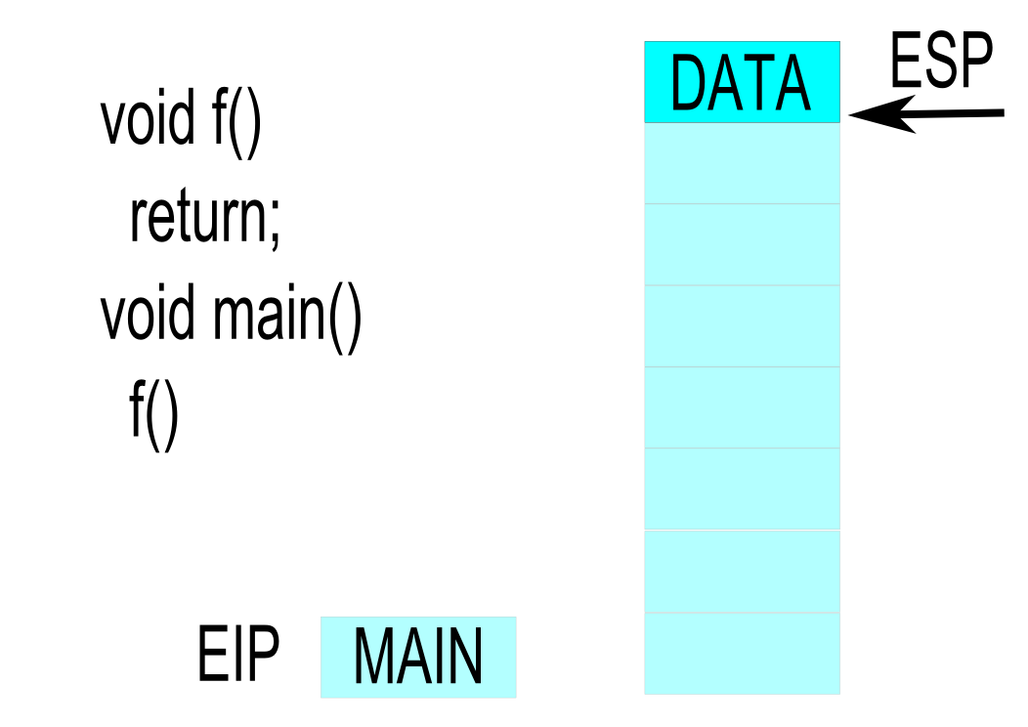
Example of basic call sequence

Slide 4
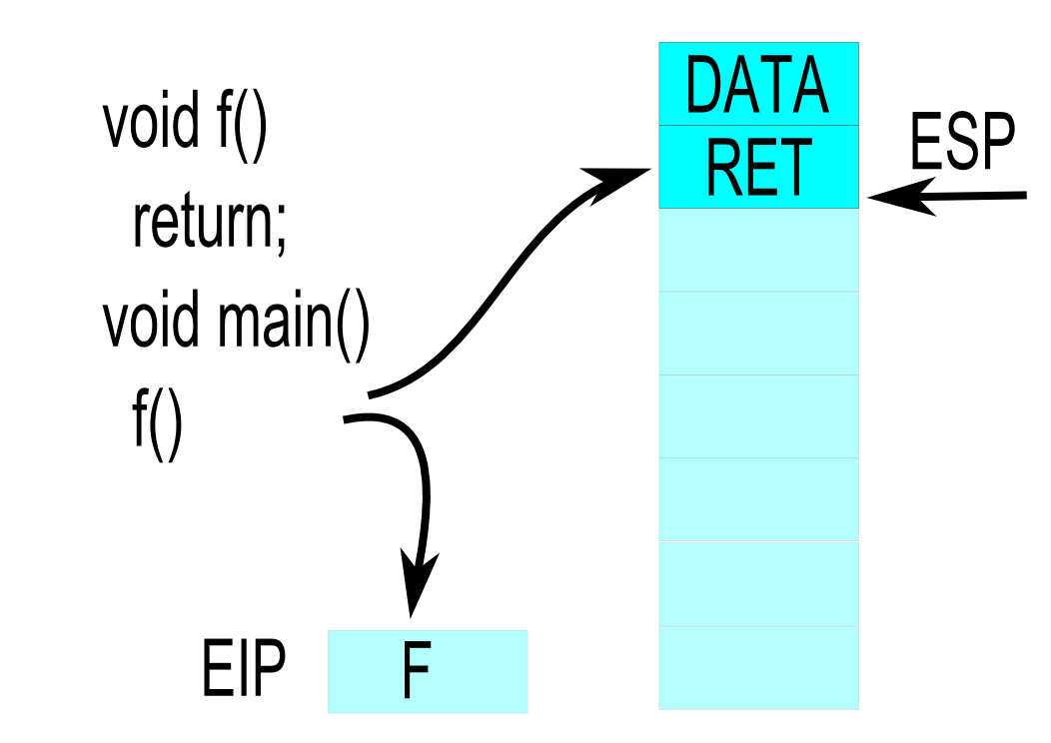
Example of basic call sequence

Slide 5
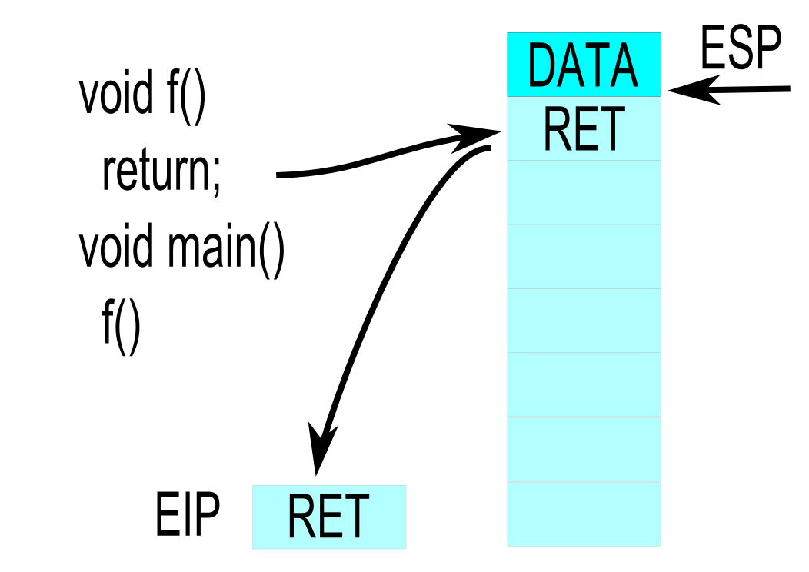
Example of basic call sequence

Slide 6
Functions in assembly
Label: Entry point of function, target of CALL
FuncName PROC
Label syntax cosmetic
End label available, but cosmetic
FuncName ENDP
Sequence of code from entry to RET
Arguments and locals on stack as follows
Return value typically in registers (EAX)

Slide 7
Function frame management
Function frame: set of arguments and locals
Ensure fixed address → Frame Pointer
Management performed by the compiler
When entering function (ENTER)
PUSH EBP ← Save previous base pointer
MOV EBP, ESP ← Get current base pointer
When exiting function (LEAVE)
MOV ESP, EBP ← Restore stack pointer
POP EBP ← Restore base pointer

Slide 8
Local arguments on the stack
Allocated on stack beneath base pointer
int arr[100] ← SUB ESP, 400 (ESP below EBP)
No typing information ← Stream of bytes
No initial value, just junk on stack
Compilers insert initialization in debug mode
Allocations may be combined
int a
int arr[100] ← SUB ESP, 408
int b

Slide 9
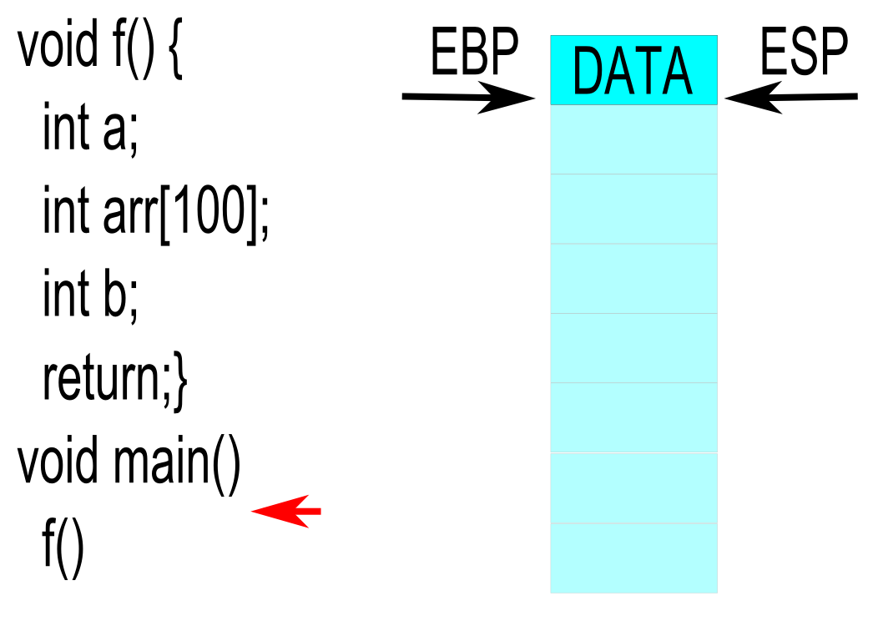
Example with frame pointer

Slide 10
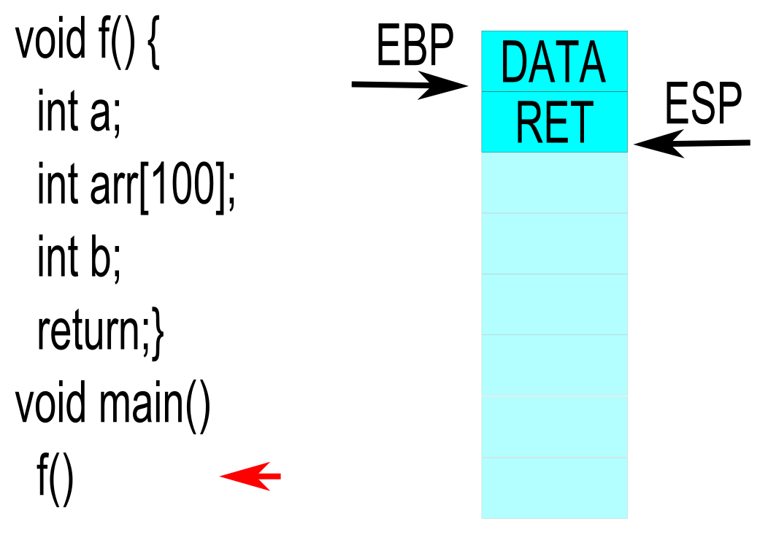
Example with frame pointer

Slide 11
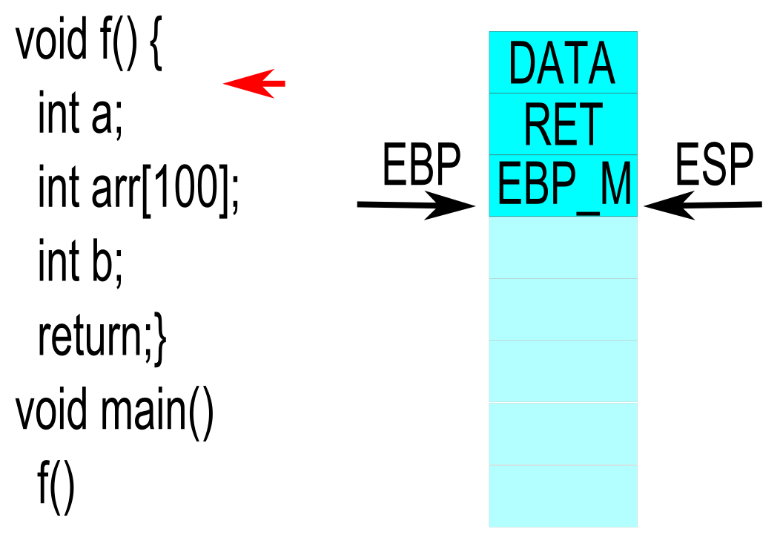
Example with frame pointer

Slide 12
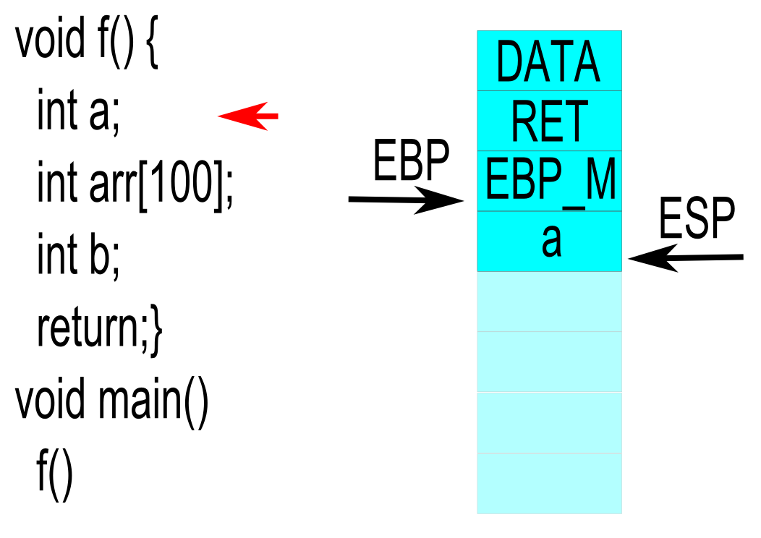
Example with frame pointer

Slide 13
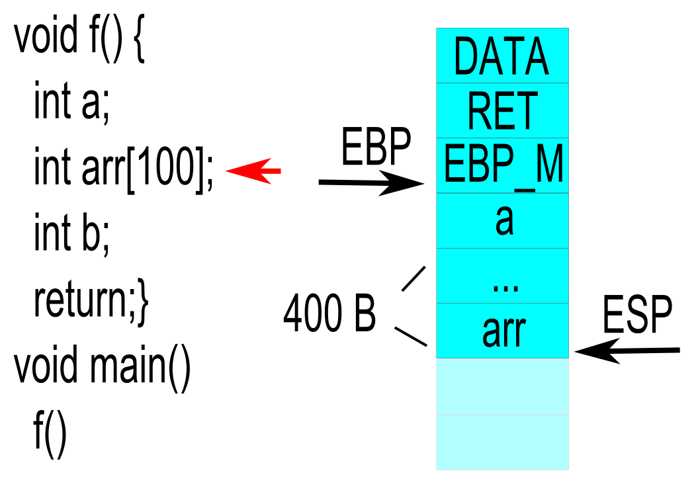
Example with frame pointer

Slide 14
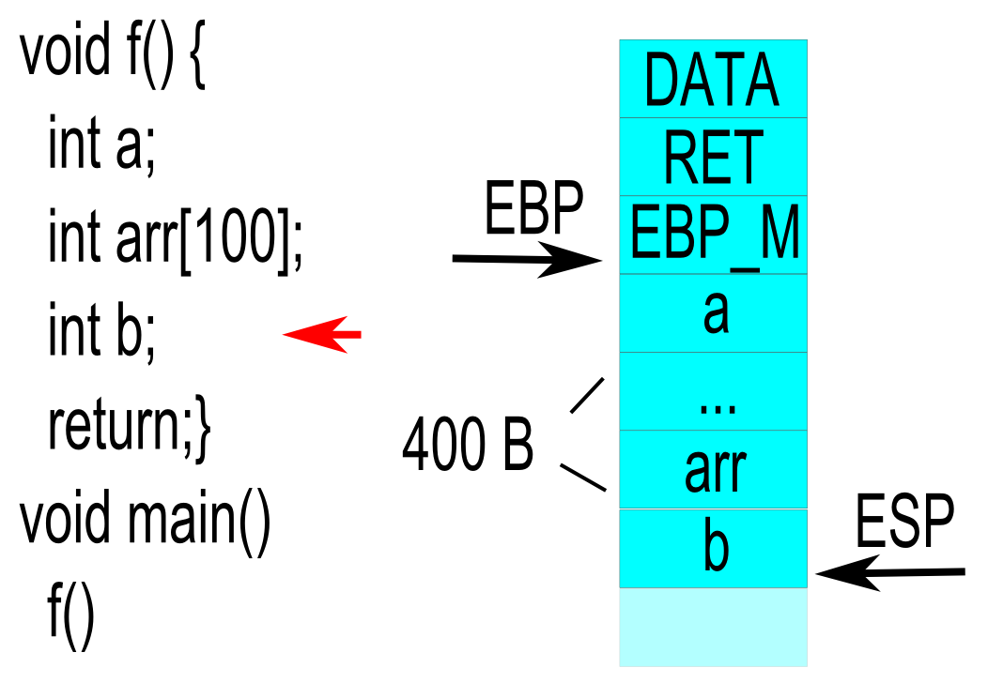
Example with frame pointer

Slide 15
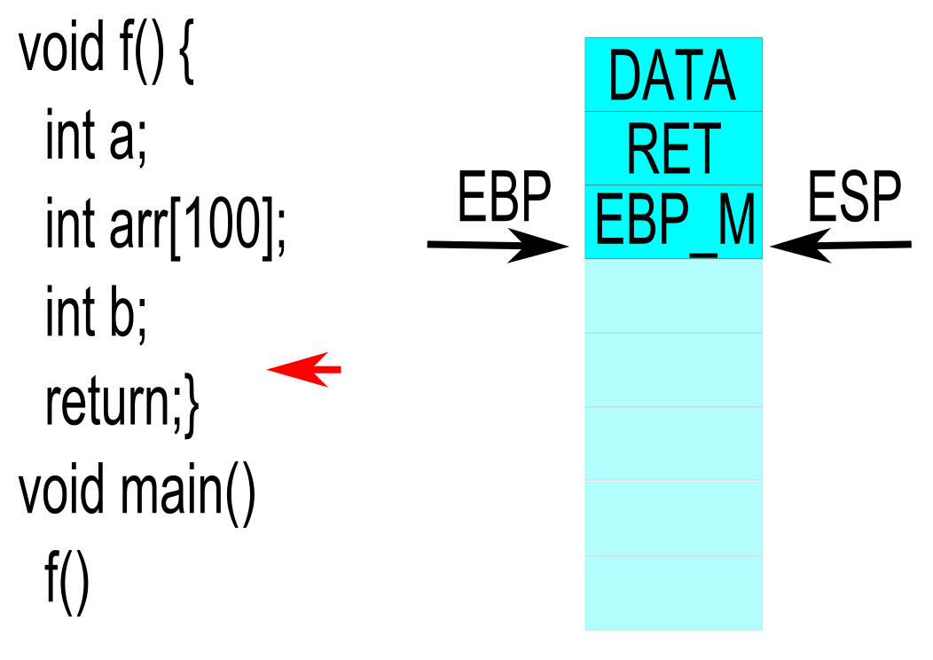
Example with frame pointer

Slide 16
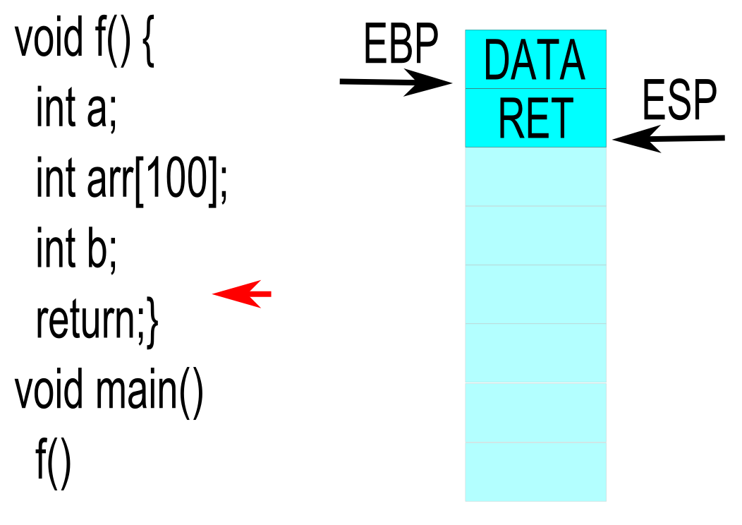
Example with frame pointer

Slide 17
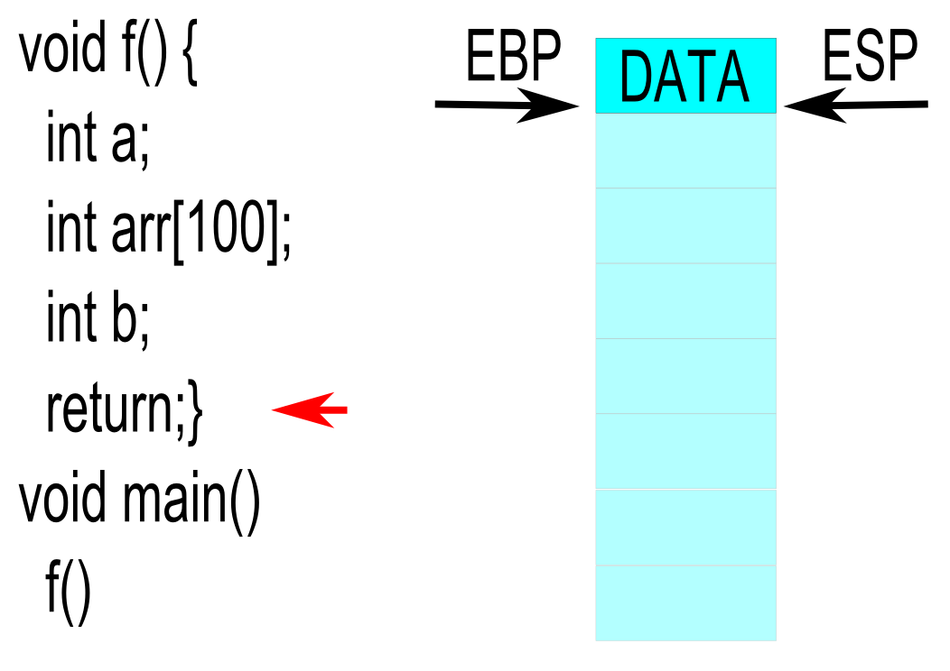
Example with frame pointer

Slide 18
Compiler transformations
Locals may be allocated separately or grouped
Typically grouped together
ESP typically 16 byte aligned (for performance)
Padding added after allocation
SUB ESP, 416 (4 * 100 + 4 + 4 + 8 for padding)
Temporary allocations may also be merged
Scoped allocations, registers saved to stack, etc.

Slide 19
Calling conventions
Defines the standard for passing arguments
Caller and callee need to agree
Enforced by compiler
Important when using 3rd party libraries
Different styles ↔ different advantages

Slide 20
Register calling convention
Pass arguments though registers
Register roles clearly defined
Only for limited argument count
Registers still save on stack in callee
Extra registers for arguments on 64 bit

Slide 21
System V AMD64 ABI
Used on *NIX systems
Integer or pointer arguments passed in:
RDI, RSI, RDX, RCX, R8, and R9
System calls: R10 is used instead of RCX
Floating point arguments use XMM registers
Additional arguments on stack
Microsoft x64 calling convention similar
Uses: RCX, RDX, R8, R9

Slide 22
Pascal calling convention
Defined by Pascal programming language
Argument ordering: left → right
Callee cleans stack
Code not repeated for every caller
Argument count must be fixed
_stdcall (Win32 API) is a variation of it
Reverse argument ordering

Slide 23
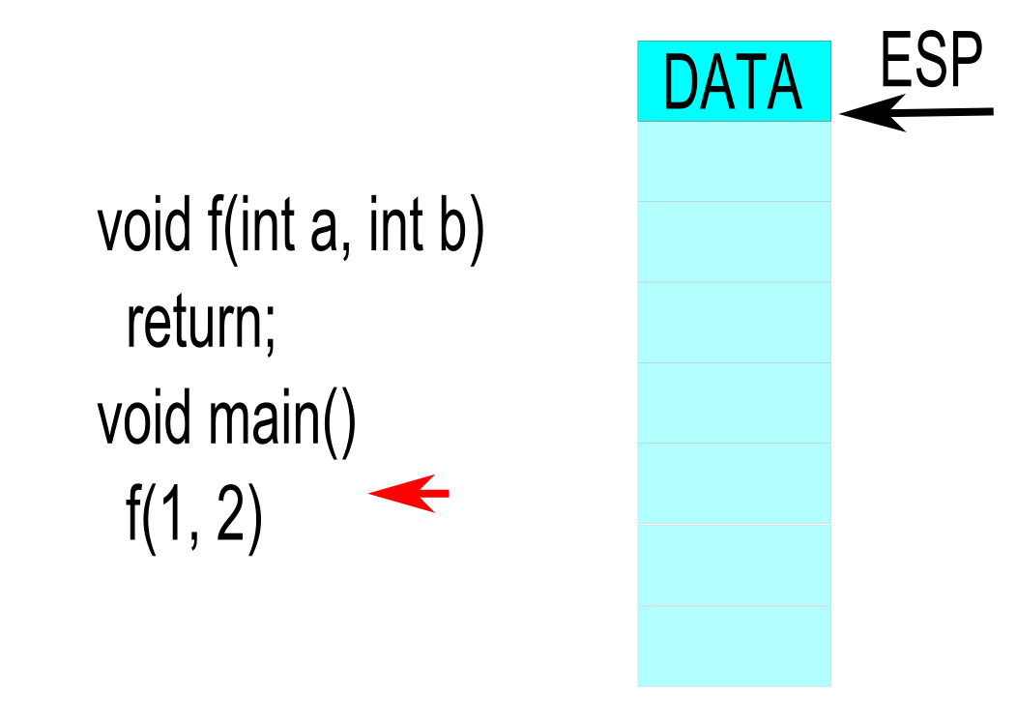
Pascal calling convention example

Slide 24
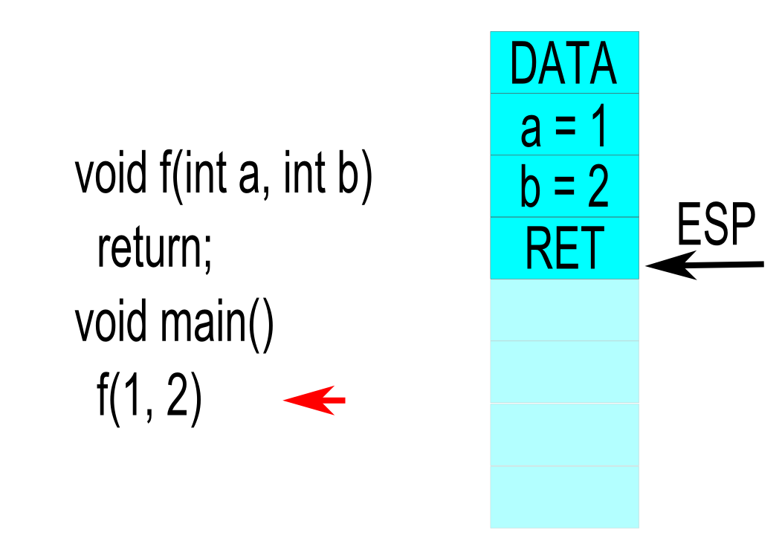
Pascal calling convention example

Slide 25
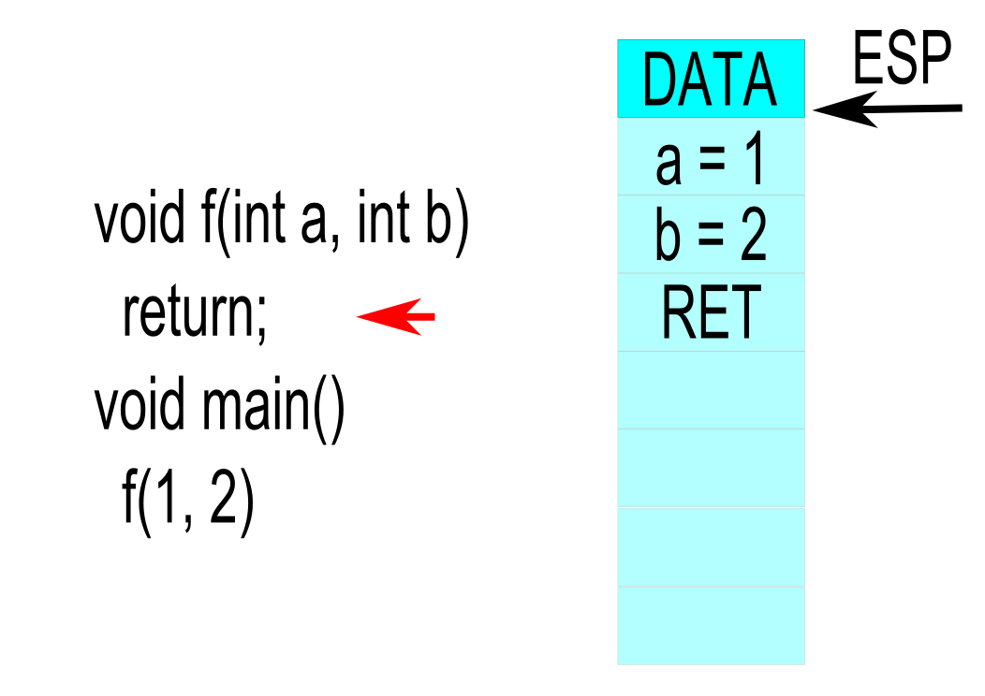
Pascal calling convention example

Slide 26
What about varargs?
Variable argument count relevant
printf function in C
Only caller knows exact argument count
Caller needs to clean arguments
What about argument ordering?
Let's look at the stack again!

Slide 27
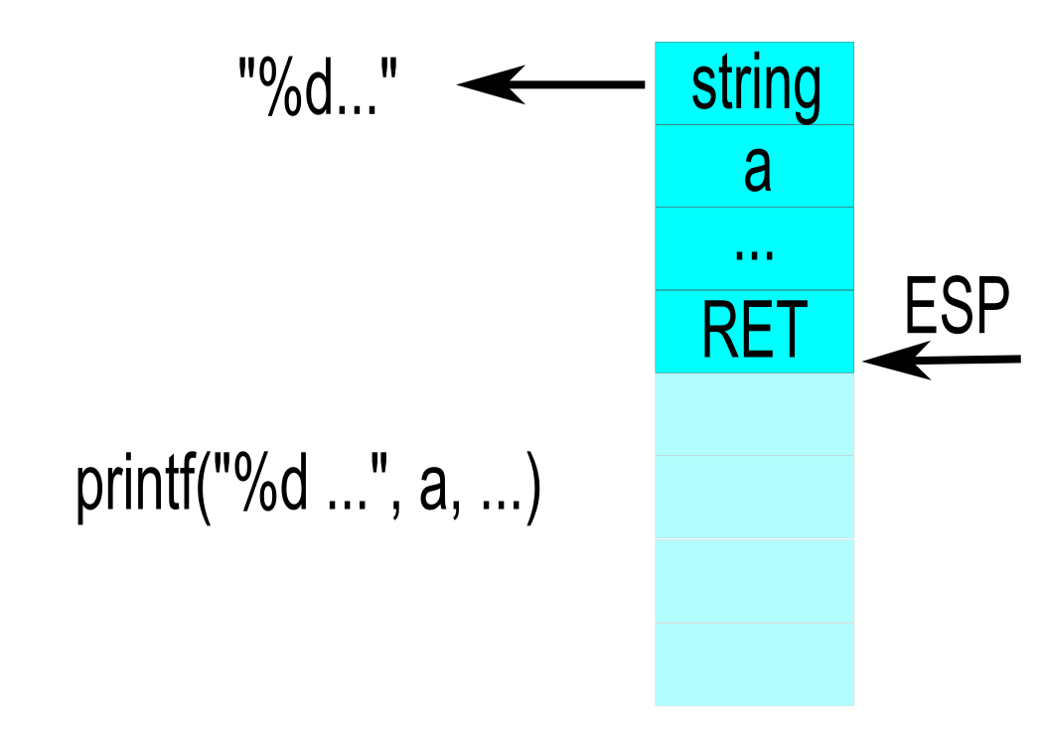
Left→Right argument ordering

Slide 28
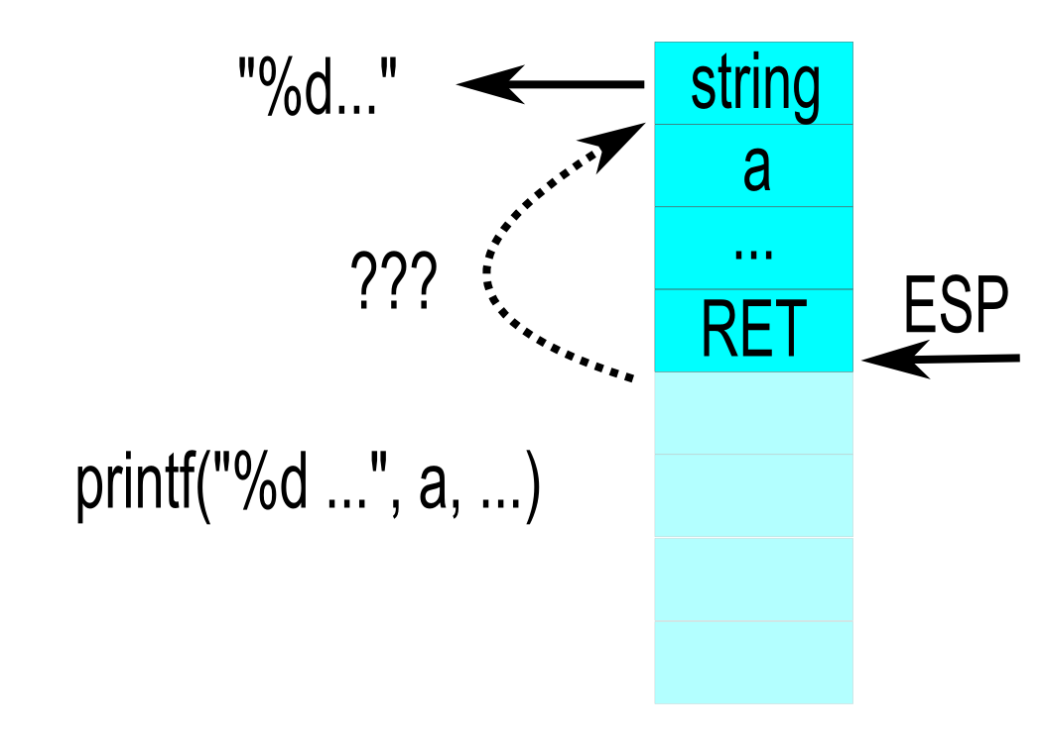
Left→Right argument ordering

Slide 29
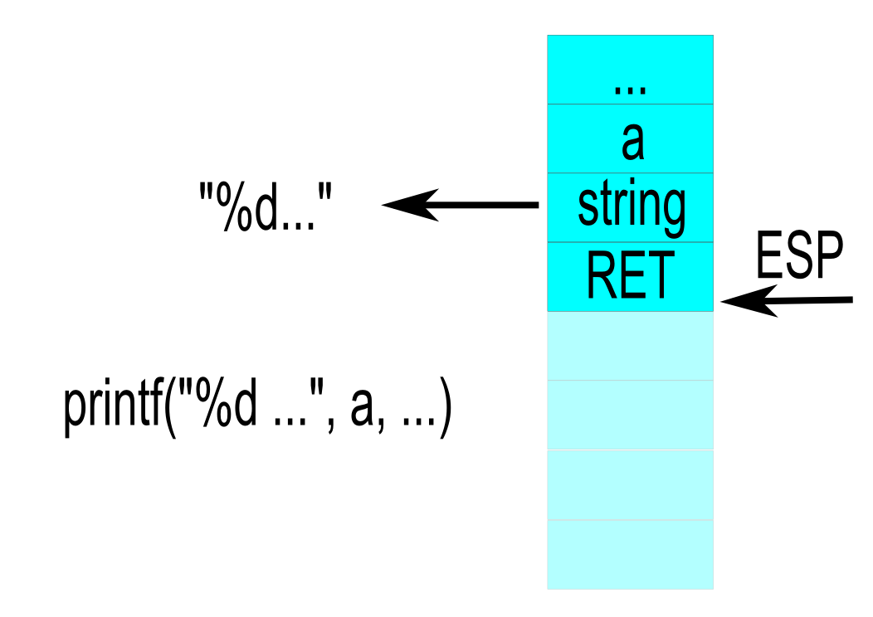
Right→Left argument ordering

Slide 30
Using varargs
Compiler has no information about length
Argument count encoded in fixed arguments
Like the format string of printf
Nothing enforces correctness!
Does a mismatch crash the application?
No; Arguments are cleaned by caller
Still a security vulnerability

Slide 31
Mismatched varargs

Slide 32
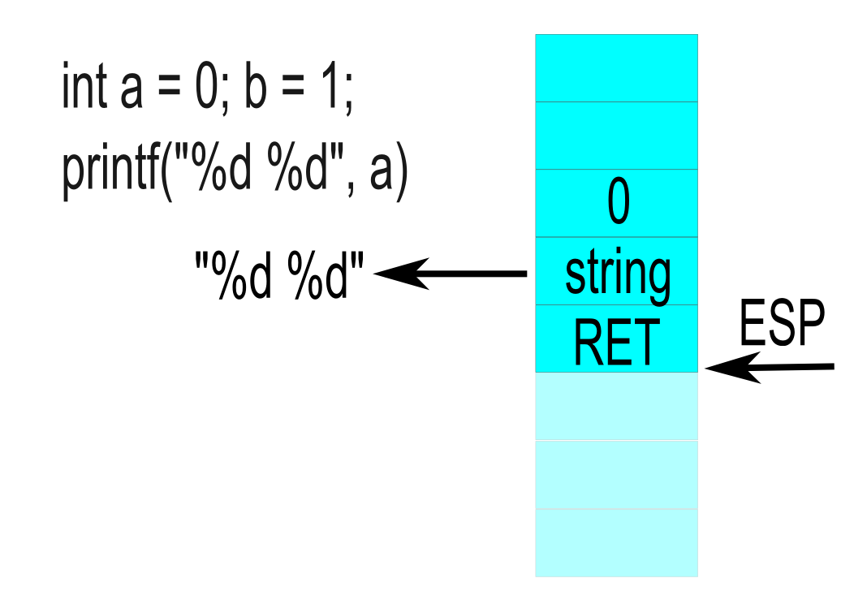
Mismatched varargs

Slide 33
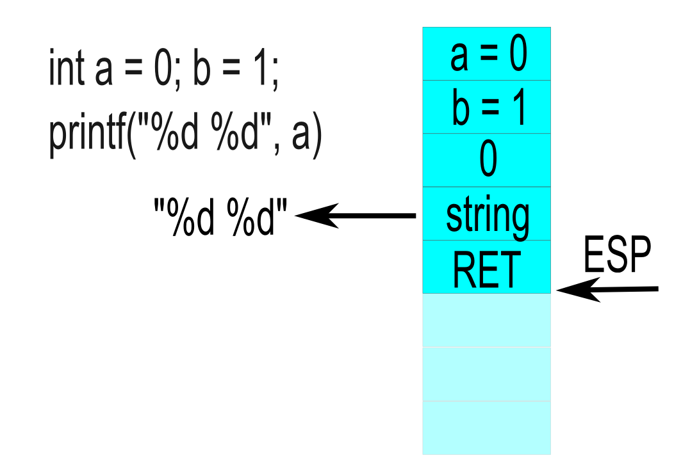
Mismatched varargs

Slide 34
C calling convention
Argument ordering: right → left
Location of first arguments known on stack
Caller cleans stack
Allows variable argument count
Default convention for GCC
Known as _cdecl

Slide 35
C calling convention example

Slide 36
C calling convention example

Slide 37
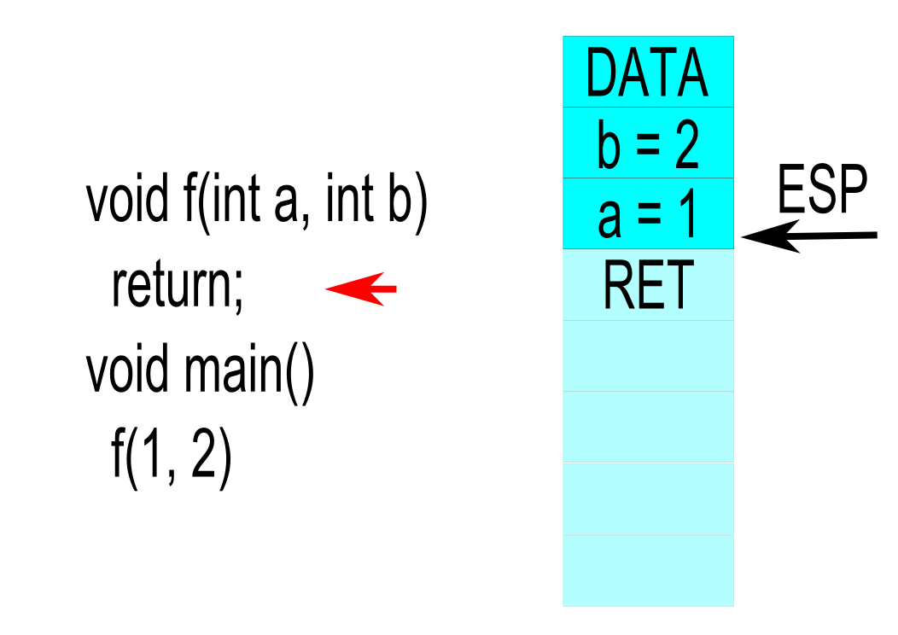
C calling convention example

Slide 38
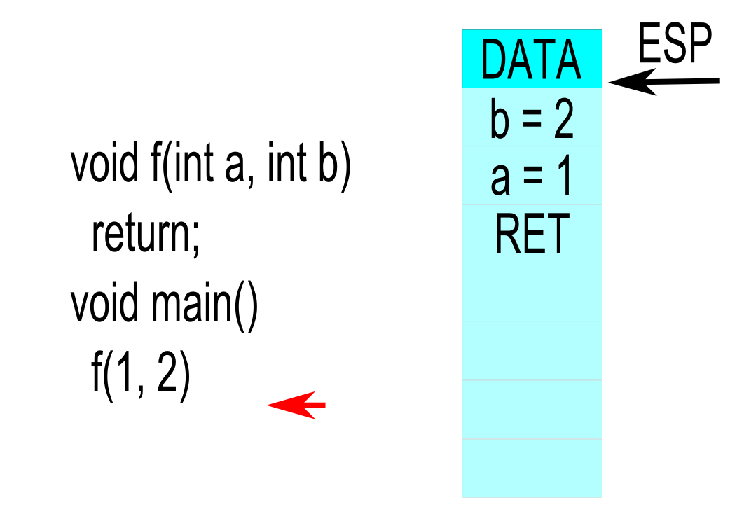
C calling convention example

Slide 39
Hardware interaction with interrupts
Multiple hardware devices connected to CPU
Cannot poll devices continuously
Necessity for notification mechanism
Asynchronous events
Specialized handling routine
Ability to run in parallel with regular code

Slide 40
Operating principle of interrupts
Interrupt occurs, CPU stops regular execution
After finishing current instruction
Function table contains pointers for handlers
CPU looks up table entry based on identifier
Execution jumps to handler (CALL)
Handler saves registers to stack!
Handler finishes and returns execution

Slide 41
Influence on regular execution
Execution interrupted after current instruction
Program state not saved!
Temporary computations still in registers!
Flag register is saved automatically
Handler should consider rest of state

Slide 42
Writing interrupt handlers
Same as regular function
Terminates with IRET
No arguments
Stack not relevant above initial stack pointer
Interact through global memory
Simplicity is key, minimize “interruption”

Slide 43
Software interrupts
Interrupts can also incur from software
Software exceptions generate interrupts
Divide by zero, Page fault, etc.
Interrupts can be triggered manually
INT X
Useful to notify kernel from user code

Slide 44
System calls using interrupts
Traditional implementation of system calls
Software interrupt can bridge privilege levels
Execution under “user” control
Possible to use arguments in registers
User space code manages interrupt
Moves arguments to specific registers
Triggers system interrupt (Linux: 80h)

Slide 45
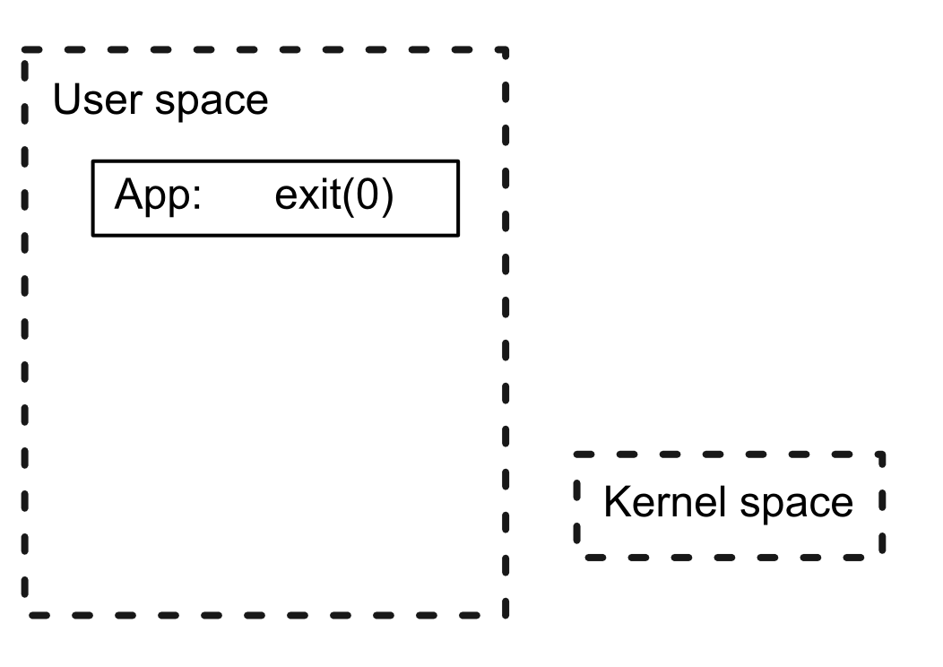
System call flow

Slide 46
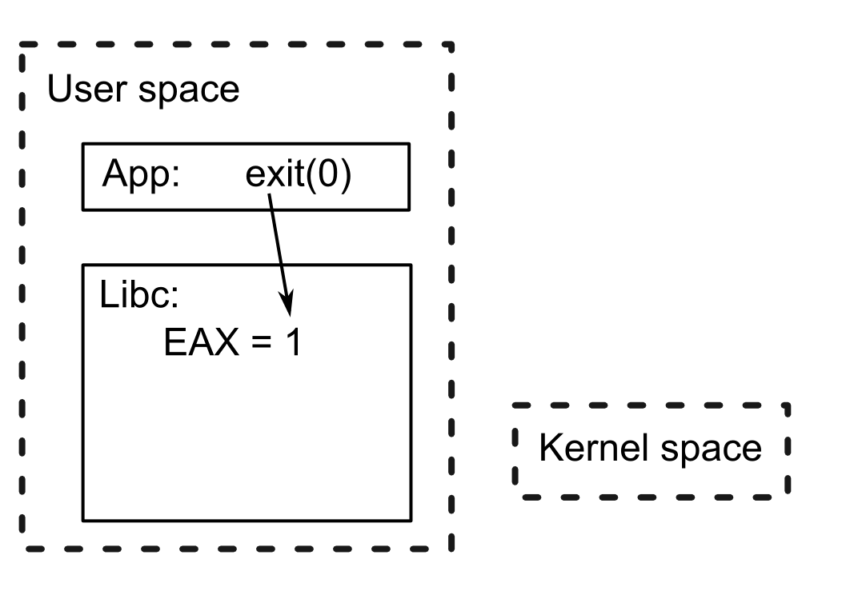
System call flow

Slide 47
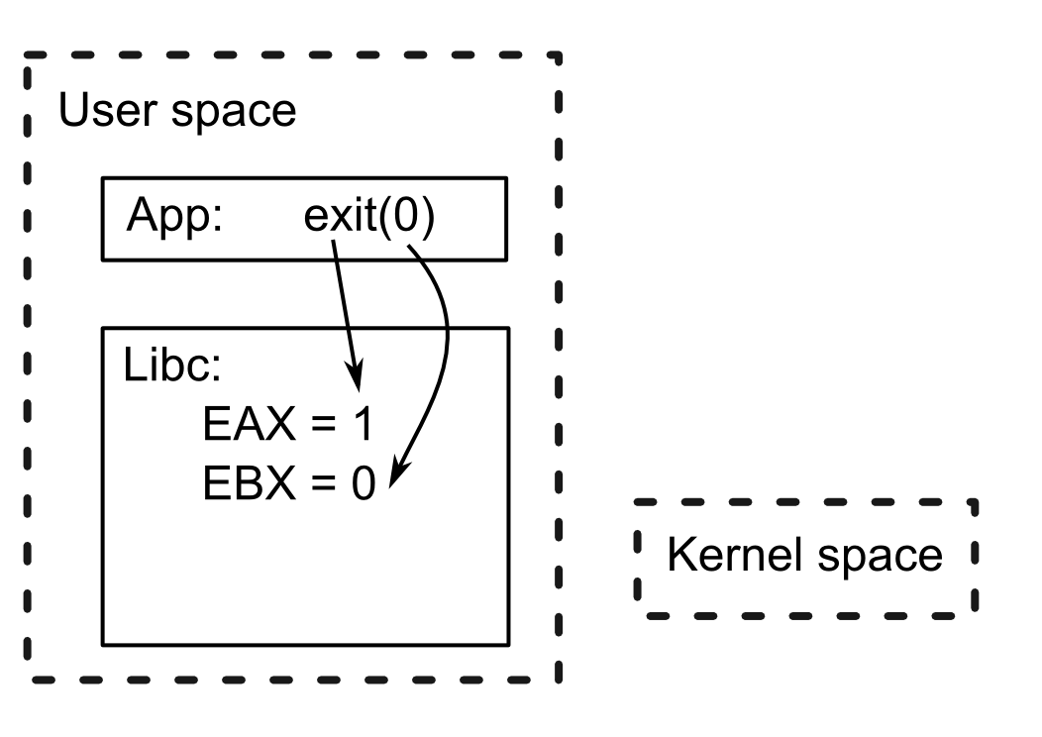
System call flow

Slide 48
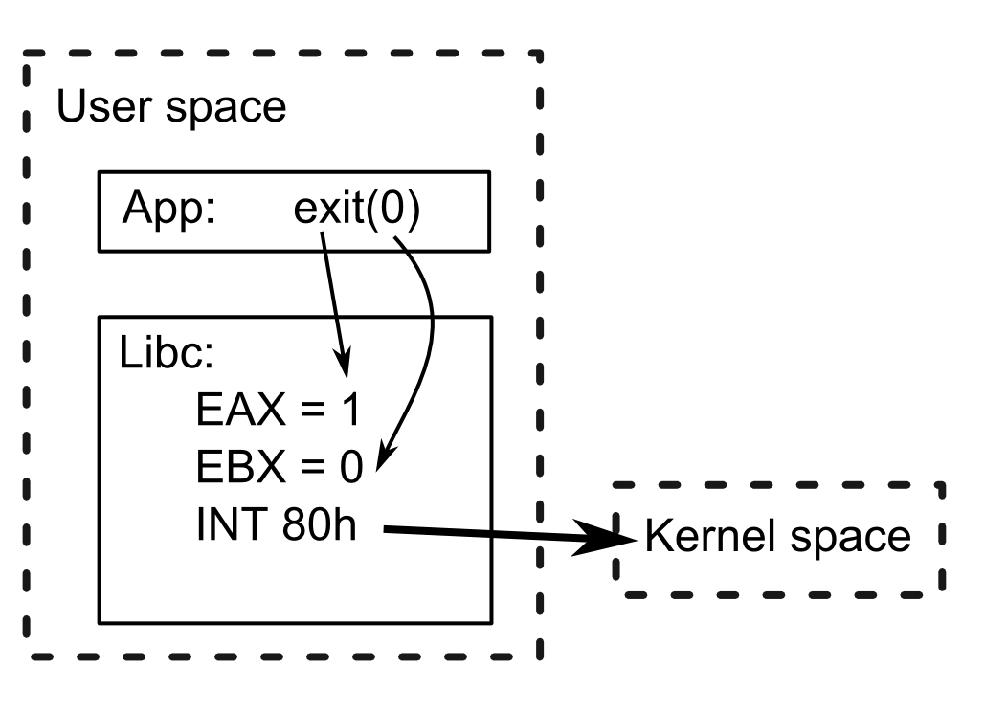
System call flow

Slide 49
Preemption in operating systems
How to schedule multiple tasks on s single CPU?
Preemptive operating systems
Scheduling performed by the OS
Applications forced to accept scheduling policy
Non-preemptive operating systems
Cooperative scheduling
Tasks control their own execution
Resources handed over when reaching checkpoints

Slide 50
Preemption with interrupts
Task has monopoly over CPU when executing
Interrupt can pause task execution
OS kernel notified and performs scheduling
Task can resume as normal whenever OS wants
Same effect as long “interrupt”
Typical interrupt for preemption: timer
Invoke scheduler every X time-units

Slide 51
Dynamic memory management
Stack+Globals for allocation known in advance
Adaptive allocation necessary sometimes
Why not avoid stack for more security?
Dedicated part of memory for run-time use
Heap
Managed using: malloc/free

Slide 52
Requirements of malloc
void* malloc(size)
Need to search for available memory chunk
Bitmap: mapping memory bytes to boolean flag
Bitmap representing entire address space
Allocation only in multiples of X bytes
Need to traverse large bitmap to find free space
Free-list: list of free chunks
Split most suitable free chunk in list
Quick to find free chunk

Slide 53
Requirements of free
void free(ptr)
Need to release memory chunk
Bitmap: reset boolean flags
Free-list: add chunk back to list
Fragmentation: malloc splits, free does not restore
Need to merge with neighboring free chunk
Inline free-list: allocation info inline with data
Quickly check neighbors of chunk

Slide 54
Doug Lea’s Malloc
Memory chunks can be allocated or free
Free chunks cannot be neighbors
Inline free-list:
Allocated chunk contain:
SIZE: size of chunk + status bits
PREVIOUS_SIZE: size of previous chunk (“pseudo” ptr)
Free chunks also contain:
FORWARD: next free chunk in doubly linked list
BACKWARD: previous free chunk in list

Slide 55
Memory allocation
Find suitable free memory chunk in free-list
Can be split from larger free chunk
Remove chunk from free-list (unlink)
If split occurred, add back remainder
Set up SIZE for chunk
Also PREVIOUS_SIZE for next one
Return pointer to user

Slide 56
Memory deallocation
Check memory chunk at the front if allocated
Using status bits
Consolidate into single chunk if free
Check memory chunk at the back if allocated
Using current pointer and SIZE to find its start
Consolidate into single chunk if free
Consolidation requires removing old chunk (unlink) and adding inserting new one in list

