Slide 1
Programming system code
by Istvan Haller

Slide 2
Topics to be discussed
Execution modes of X86 CPUs
Programming possibilities in the different modes
Programming with BareMetal OS
  A simple OS with full programmer control
Linux guide from assembly to process

Slide 3
Execution modes
Different modes as the hardware evolved
  16 → 32 → 64 bit architecture
  Memory protection for safety and security
Old variants still available for legacy support!
Boot in basic mode, ask CPU for more features

Slide 4
Legacy???
Situation: 16-bit software on 16-bit hardware
  Perfect synergy, optimal performance

Slide 5

Legacy???
Small community: why not 32-bit?
  Memory range too limited (1MB with 20-bit)
  Integer range limited (16-bit cannot handle 100k)

Slide 6
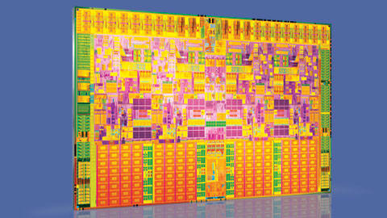
Legacy???
Response from hardware community
  Production technology advanced enough!
  Possible to redesign architecture
  Boost in performance and feature set

Slide 7

Legacy???
But where are the buyers?
Software community: Wait for us!
No sales ☹ until software is redesigned

Slide 8
Solution: Legacy support!
Ensure that all previous features still supported
Ensure that yesterday’s software still runs today
But how?
  CPU starts up in legacy mode
  Additional features activated only on request
  New software leverages benefits (hopefully)
You can boot into MS-DOS from any X86 CPU

Slide 9
16-bit Real Mode
Original operating mode of 8086
16-bit words, 20-bit addresses
  Two address components: segment (base) + offset
  A = S*16 + O
1MB total memory, 64KB segments
Full hardware access, no protection
Hardware transparency through BIOS

Slide 10
What is BIOS?
Basic Input Output System
Standardized interface for basic I/O components
  Keyboard, hard disk, video memory
  Grandfather of system calls
Implemented by motherboard manufacturer
  Hardware dependent
  Firmware updates for new features
Started up after powering CPU

Slide 11
32-bit Protected Mode
Enables 32-bit extensions
  Up to 4GB addressable memory
Introduces protection mechanisms
Kernel mode vs User mode execution
  Privilege rings 0 → 3
Support for virtual memory: paging
  Each process with its own virtual memory (isolation)
  System maps virtual addresses to physical memory

Slide 12
64-bit Protected Mode
Enables 64-bit extensions
  Not all bits used for memory addressing yet (48 bits)
Compatibility sub-mode
  Allow parallel execution of 32- and 64-bit applications
Minimized segmentation support
  Focus on paging

Slide 13
BIOS in protected mode?
BIOS unavailable in protected mode
  System stability may be compromised otherwise
  Cannot intermix 16-bit and other code
Protected mode operating systems (Linux, Win)
  Hardware drivers for all devices
  Replicate BIOS functionality as syscalls
BIOS specific system information acquired before changing to protected mode

Slide 14
Future alternative: UEFI
Unified Extensible Firmware Interface
Based on the EFI used by Apple
Advantages
  Abstract interface between software and hardware
  Uses high-level programming concepts
  Focusses on extensibility and modularity
  Allows booting directly into protected mode

Slide 15
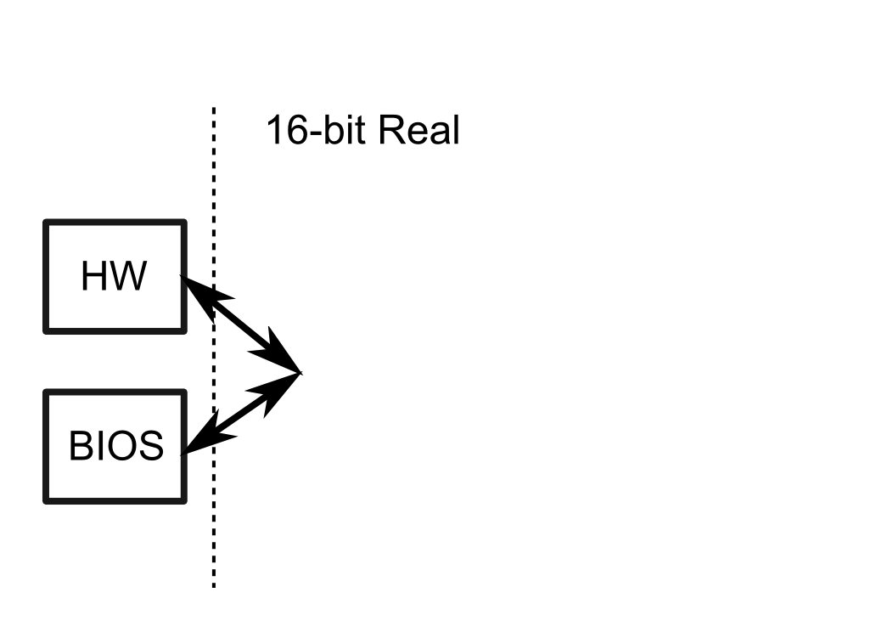
Boot process

Slide 16
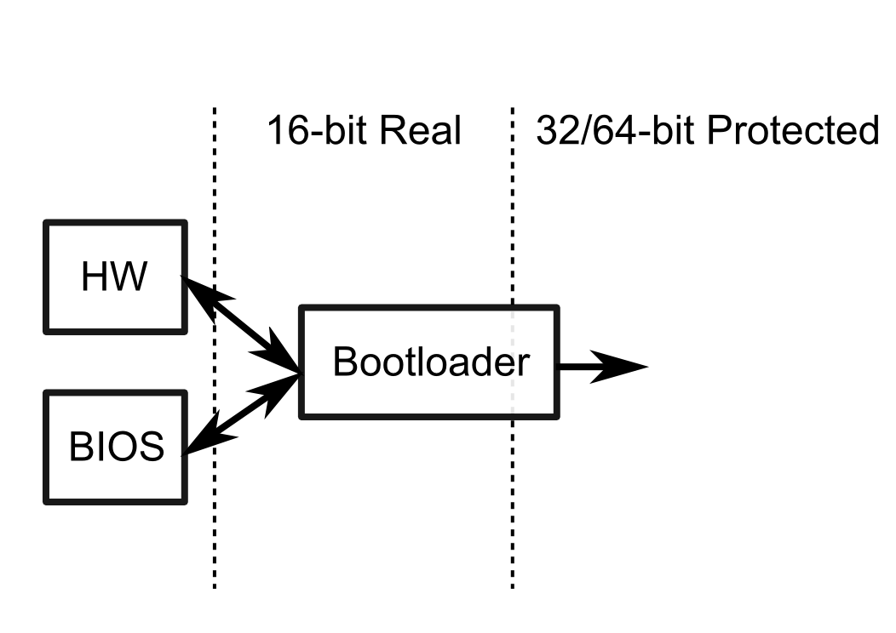
Boot process

Slide 17
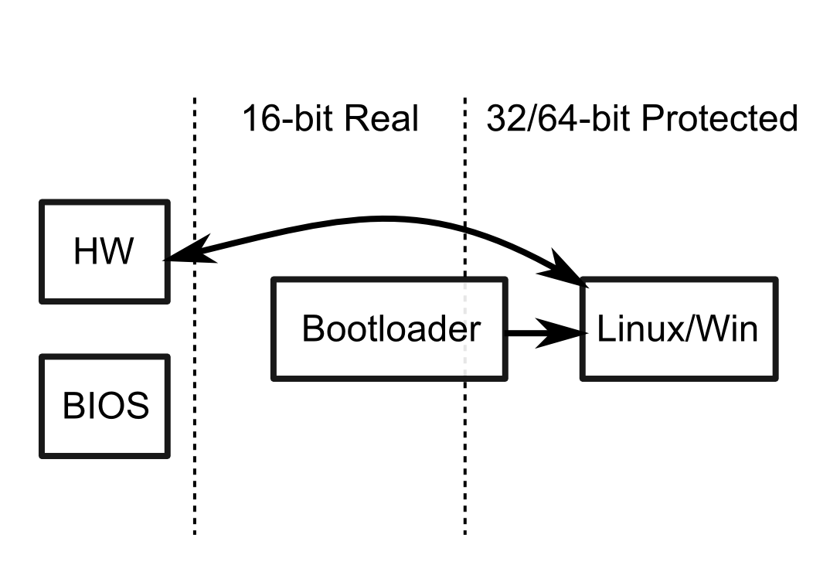
Boot process

Slide 18
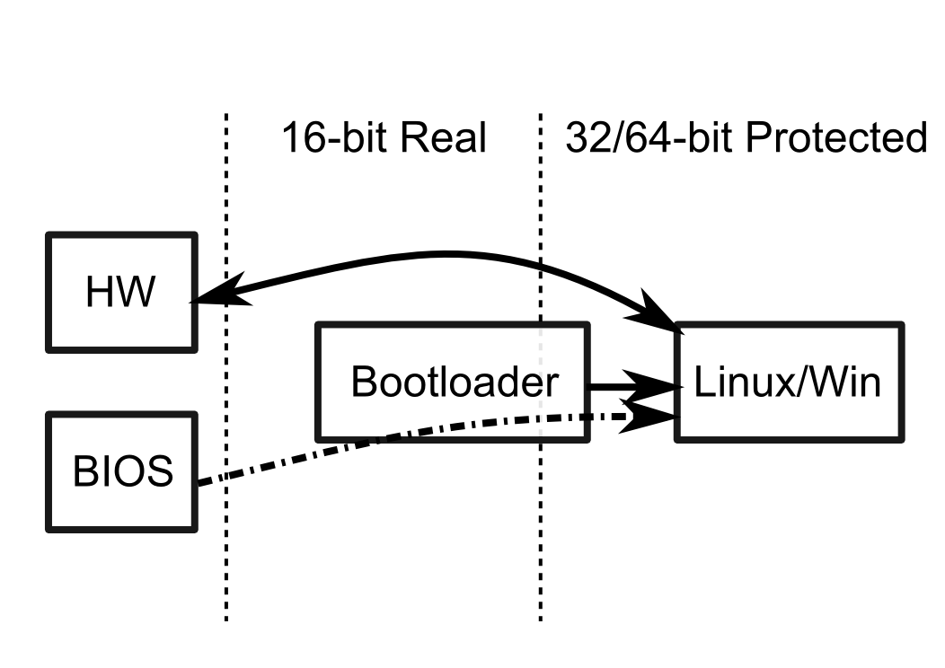
Boot process

Slide 19
Where can we insert custom code in this process?
Anywhere

Slide 20
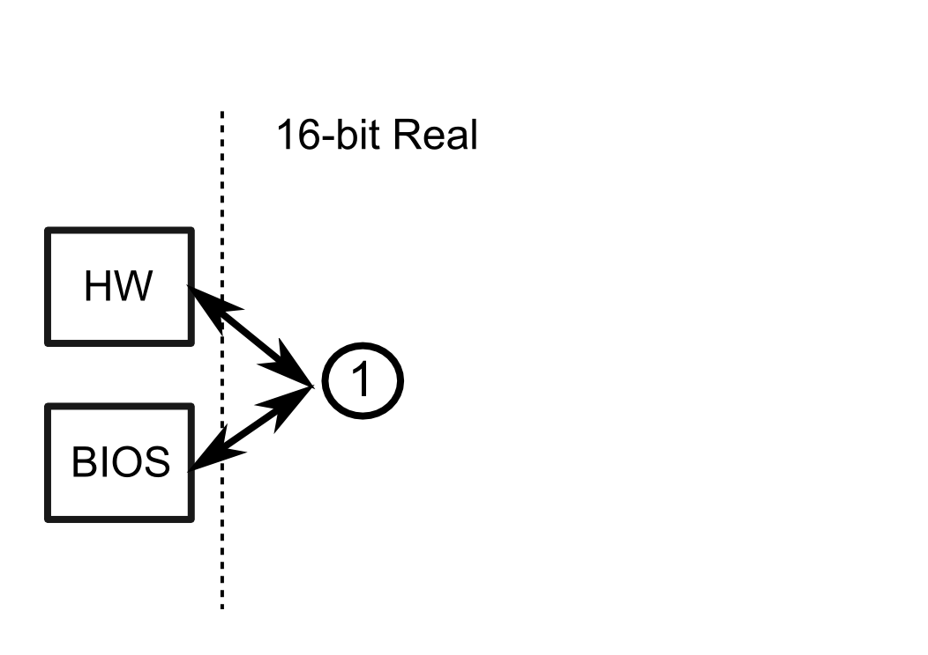
Real-mode assembly

Slide 21
Real-mode assembly
Advantages
  Full control over execution
  Uninterrupted access to hardware
  Basic I/O through BIOS
Disadvantages
  Limited to 16-bit operations
  Limited to 1MB of memory
  Limited to single core

Slide 22
Assembly in MS-DOS (FreeDOS)
Extra functionality besides BIOS
Extensive documentation available
  Most old-school lectures
  The Art of Assembly Language Programming
  TECH Help: great digital resource
Essentially same as real-mode

Slide 23
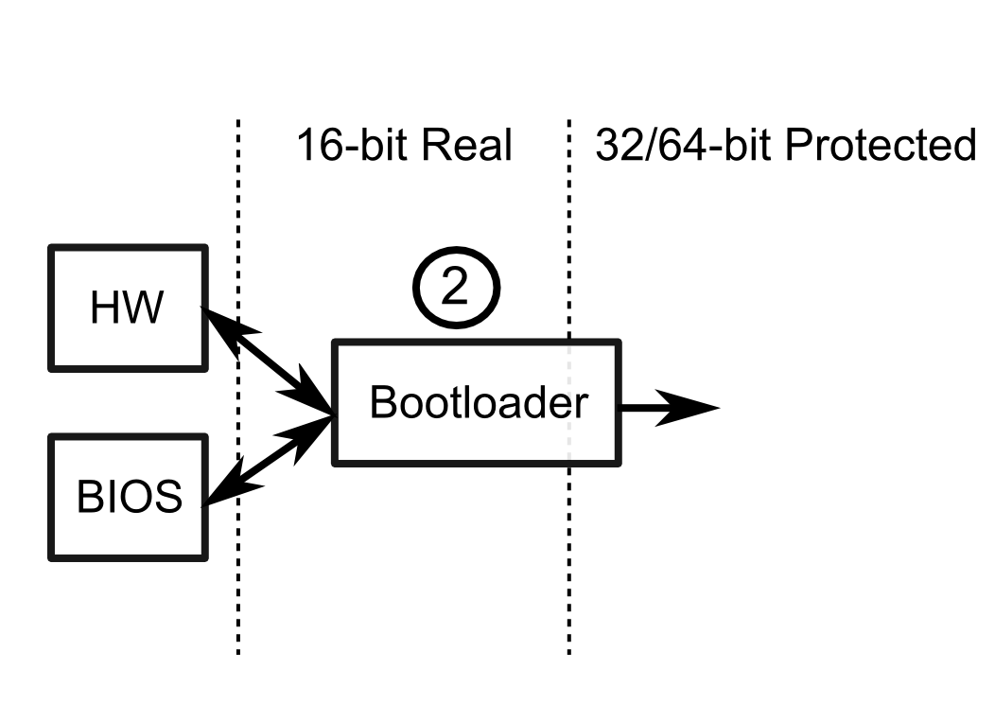
Write your own bootloader

Slide 24
Write your own bootloader
Learn both real- and protected-mode
Solve a real, hardcore problem
Applicable on modern systems
Requires following strict guide lines
  OSDev contains many resources
  Example code: GRUB (large codebase!)
Intel Bootloader Guidelines

Slide 25
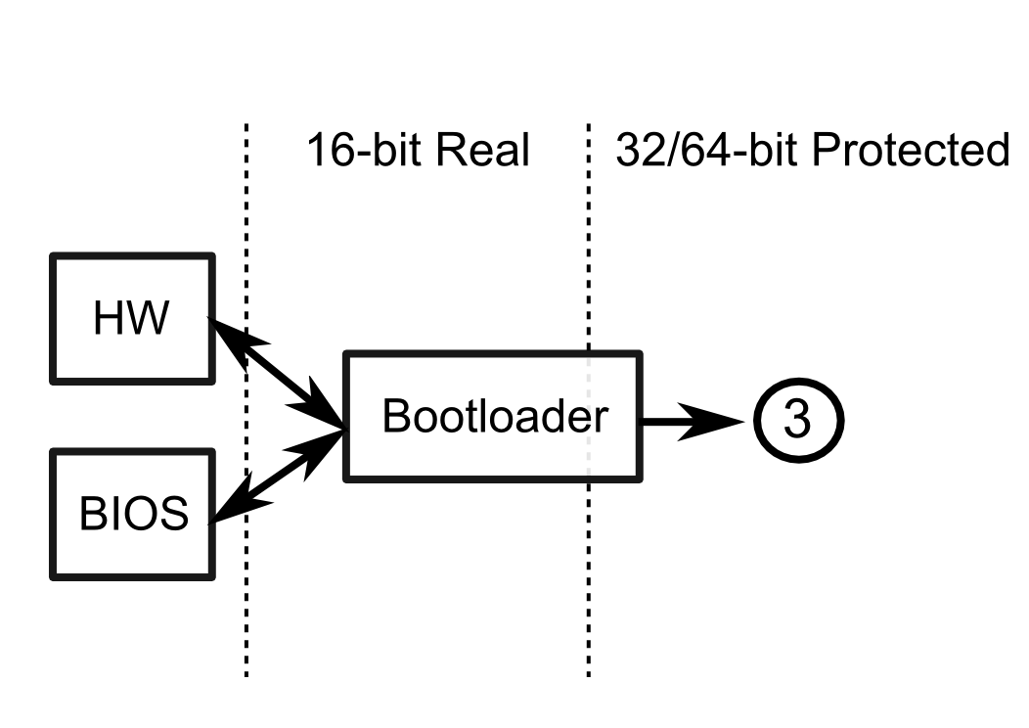
What about a “custom kernel”?

Slide 26
What about a “custom kernel”?
Use an existing bootloader, write custom protected mode code
Benefit from the most advanced protected mode
  No limitations on hardware capabilities
Full access to all components, except BIOS
Need to write custom code to manage I/O

Slide 27
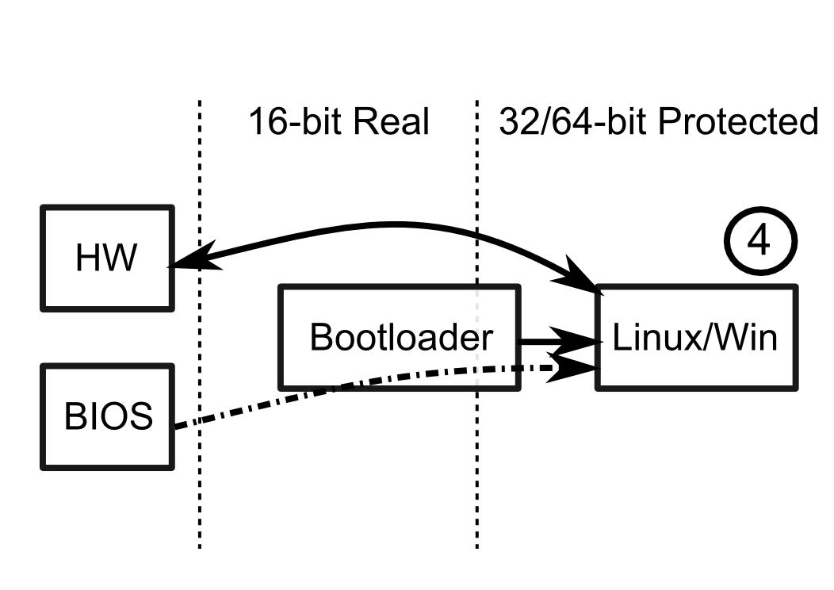
Assembly in Linux/Windows

Slide 28
Assembly in Linux/Windows
Easy to integrate into applications
Familiar programming model
Limited to OS sandbox
Develop device drivers for additional control
  Kernel modules in Linux
Typically C is more applicable

Slide 29
Recommendation
Extend existing “custom kernel”
Leverage OS facilities for early development
Learn from existing code-base
Same power as DOS-based approach, but on a modern architecture

Slide 30
BareMetal OS (5.3): complete OS in assembly
  64-bit with multi-core support
  Miniature size, minimal feature set
  Perfect for learning system interaction
  http://www.returninfinity.com/baremetal.html

Slide 31
BareMetal OS (5.3)
File System: FAT16 (File Allocation Table)
  Files partitioned into clusters (per cluster info in table)
  Used by memory cards
Shell
  Execute a single application at a time
OS functionality
  Functions resident in memory

Slide 32
Applications
Application memory range:
  Static code and data, 2MB: 200000h → 400000h
  Dynamically allocated memory areas (2MB pages)
Execution starts from 200000h
Execution stops when returning from “main”
No relocation of code/data (single process)
Interaction with OS described in header file
  Essentially syscalls without changing privilege level

Slide 33
Applications
; Compile a 64-bit application
[BITS 64]
; Memory address where application is be loaded
[ORG 0000000000200000h]
; Include the BareMetal OS function definitions
%INCLUDE "bmdev.asm“
Application examples

Slide 34
OS functionalities exported
String manipulation and printing
CLI manipulation: keyboard input and cursor
File system operations
Dynamic memory allocation
Multi-threading using SMP model
Basic networking through Ethernet
Environment management (argc/argv)
Detailed description

Slide 35
Workflow when using BareMetal
Start with QEMU or VirtualBox VM image (5.3)
  QEMU: Windows version; VirtualBox: VMDK
Check that you can boot into BareMetal OS
  Play around with the existing apps
Download source
Build your first app based on programs/hello.asm

Slide 36
Workflow using BareMetal
Understand the provided build scripts
  compileASM.sh for ASM and compileC.sh for C
Compile your application to a .app file
Use the provided script to mount the virtual disk
  Mounts the FAT16 portion under /mnt/baremetal/
Copy you application to the disk
Unmount the disk to commit the changes

Slide 37
BareMetal boot process (1)
Bootloader Pure64 started at power-up
  Read rest of Pure64 into memory (from MBR stub)
  Initialize video mode and extract BIOS memory map
  Enable 32-bit into 64-bit protected mode
  Generate CPU exception hooks
  Setup hardware components (with interrupt hooks)
  Save system information to infomap (5000H)

Slide 38
BareMetal boot process (2)
BareMetal kernel takes over execution
  Install handlers for exceptions and interrupts
  Copy Pure64 infomap (5000H) to os_SystemVariables
  Allocate kernel and application memory
  Allocate per-CPU stacks and reset CPUs
    Clear registers, reset stack, set status flags
  Initialize hard disk and network

Slide 39
What about Linux?
A short guide going from code to a running process
Learn about simplest program you can create

Slide 40
What about Linux?
Linux is multi-process
  Multiple applications loaded in memory
Large range of third-party libraries
  Static libraries combined at link-time
  Dynamic libraries shared between processes
Fixed addresses like in BareMetal not possible
Solutions: virtual memory and linker/loader

Slide 41
Virtual Memory in Linux
Memory organized in pages (blocks of memory)
Processes operate on virtual memory pages
Same virtual page from different processes correspond to different physical memory pages
OS manages mappings using CPU support
Effect: every process uses same address range
  Multiple copies of a process without address conflicts
  Possible sharing of memory pages between processes

Slide 42
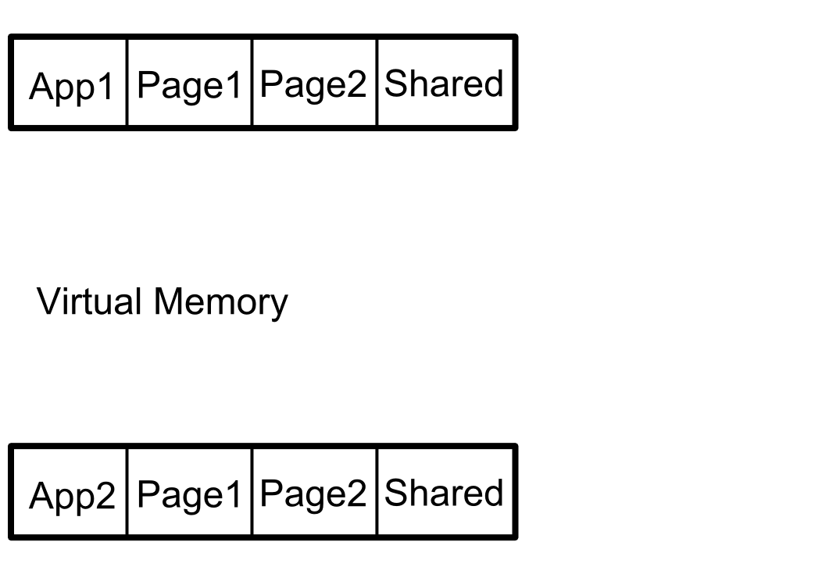
Virtual Memory in action

Slide 43
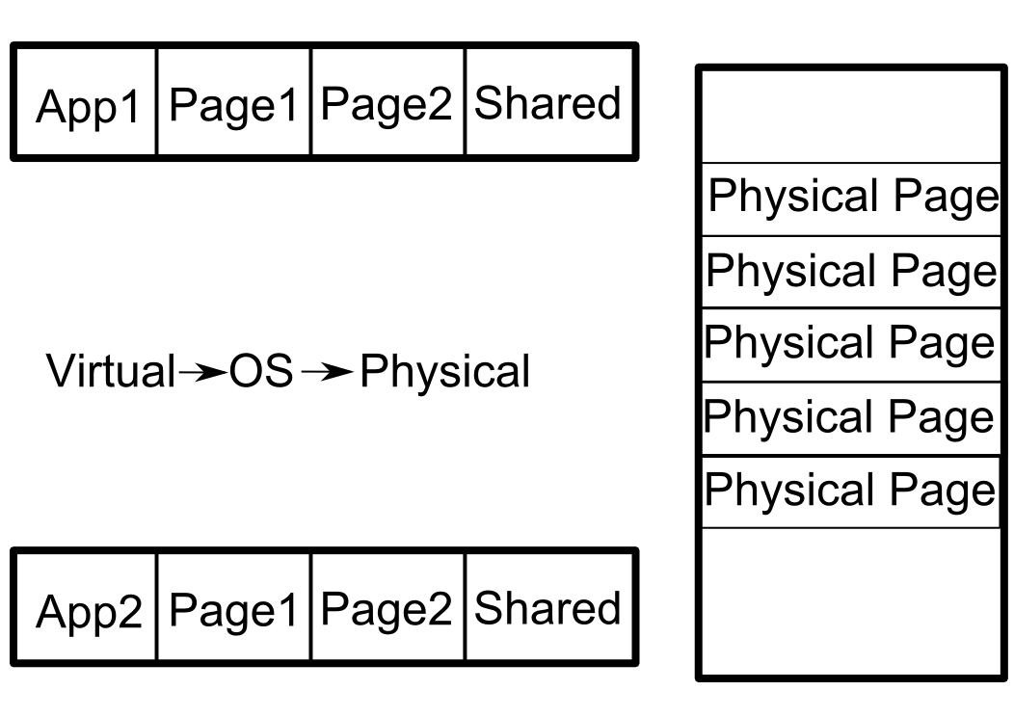
Virtual Memory in action

Slide 44
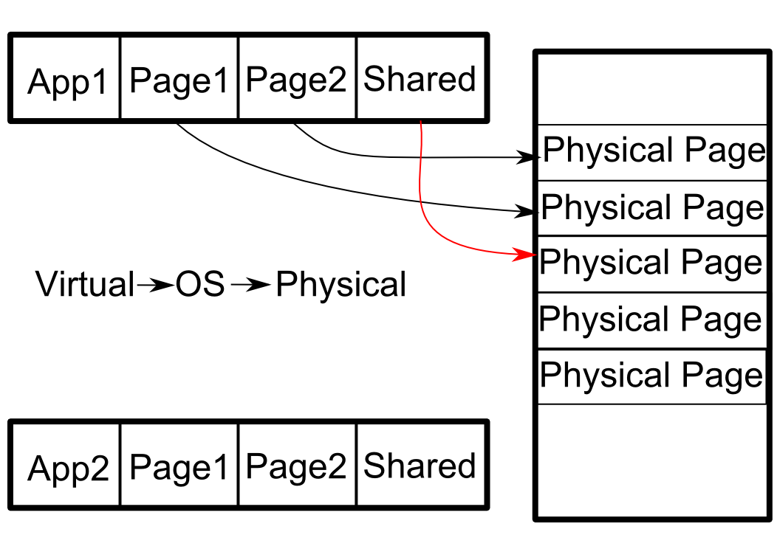
Virtual Memory in action

Slide 45
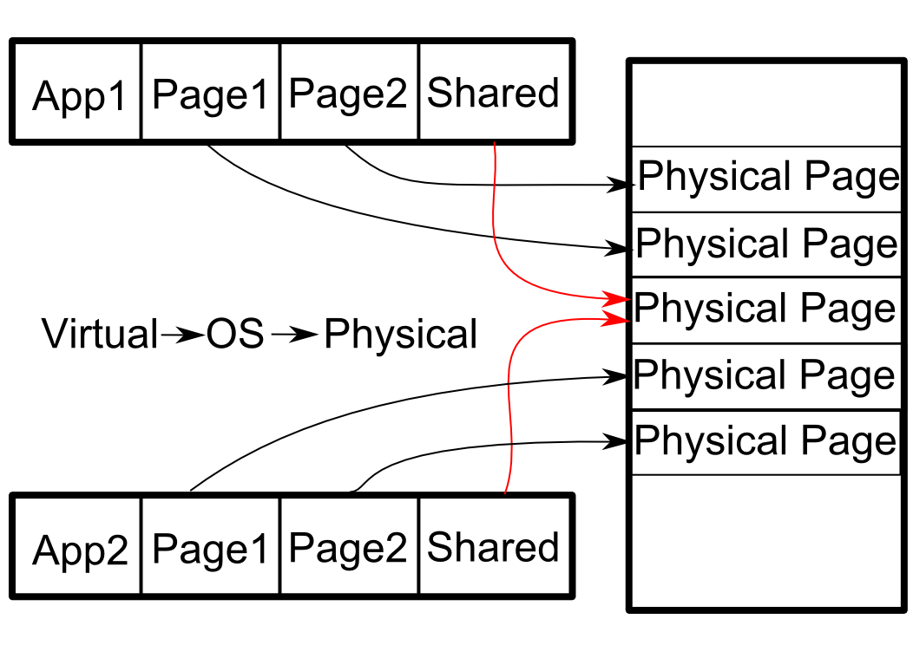
Virtual Memory in action

Slide 46
Purpose of linker
Different components split in different object files
Each object file uses the same address range
Conflicts need to be mitigated for final executable
  Organize components in continuous file
  Redefine addresses for symbols (labels)
Each object file contains symbol information
Linker relocates and merges program segments
  Resolves external links using new symbol information

Slide 47
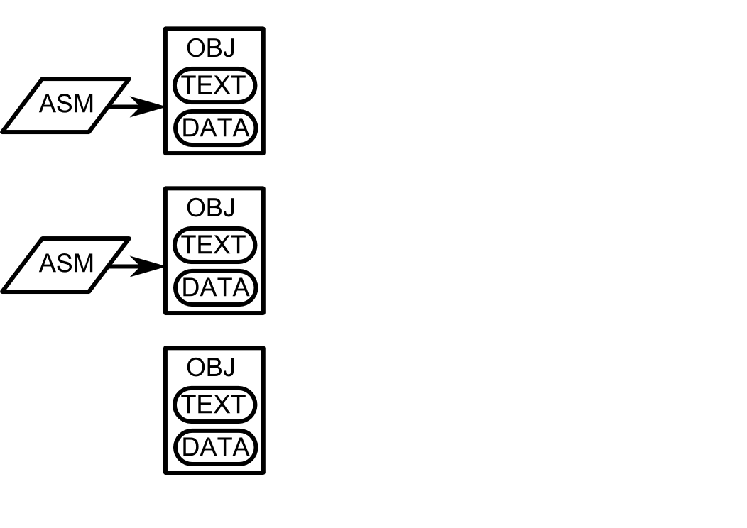
Linking operation

Slide 48
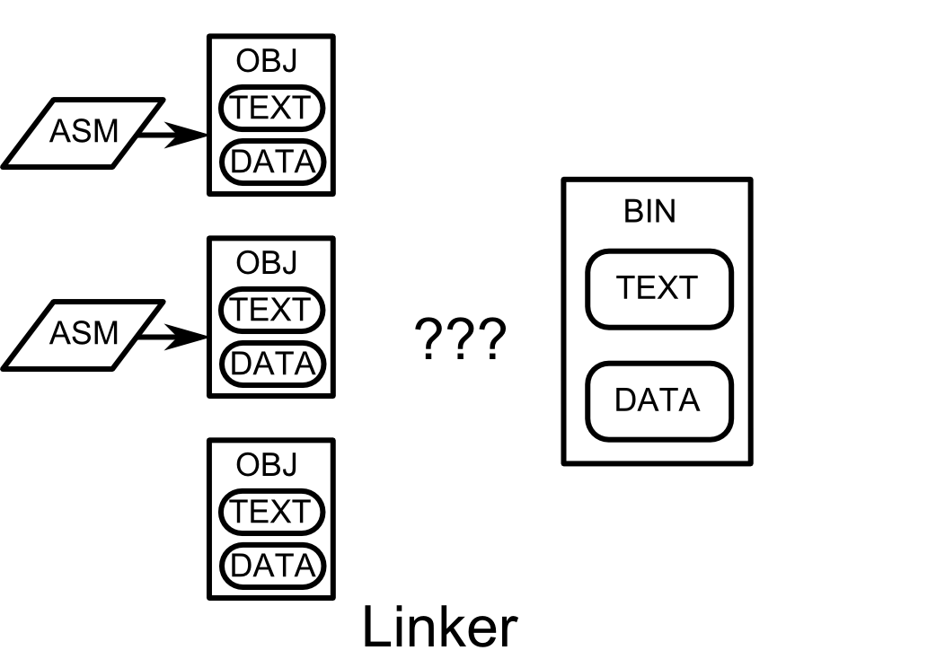
Linking operation

Slide 49
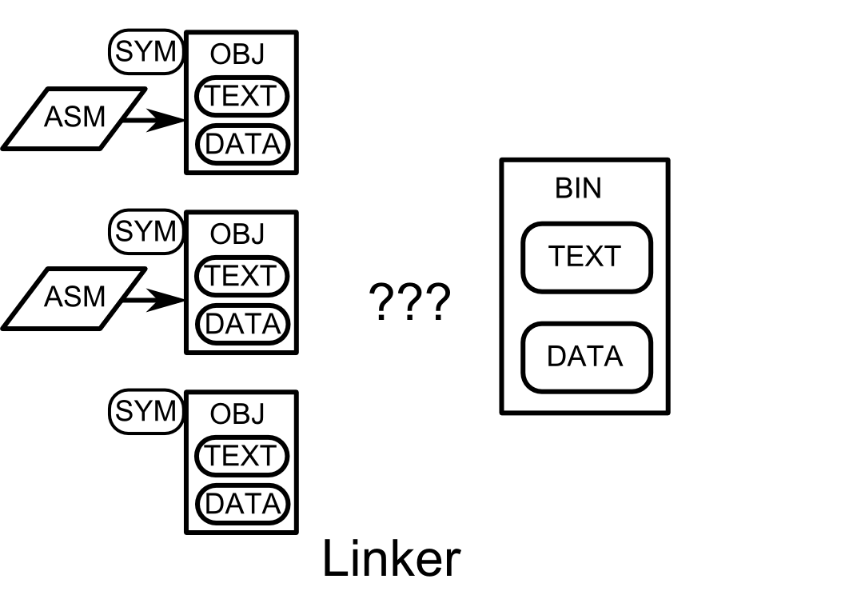
Linking operation

Slide 50
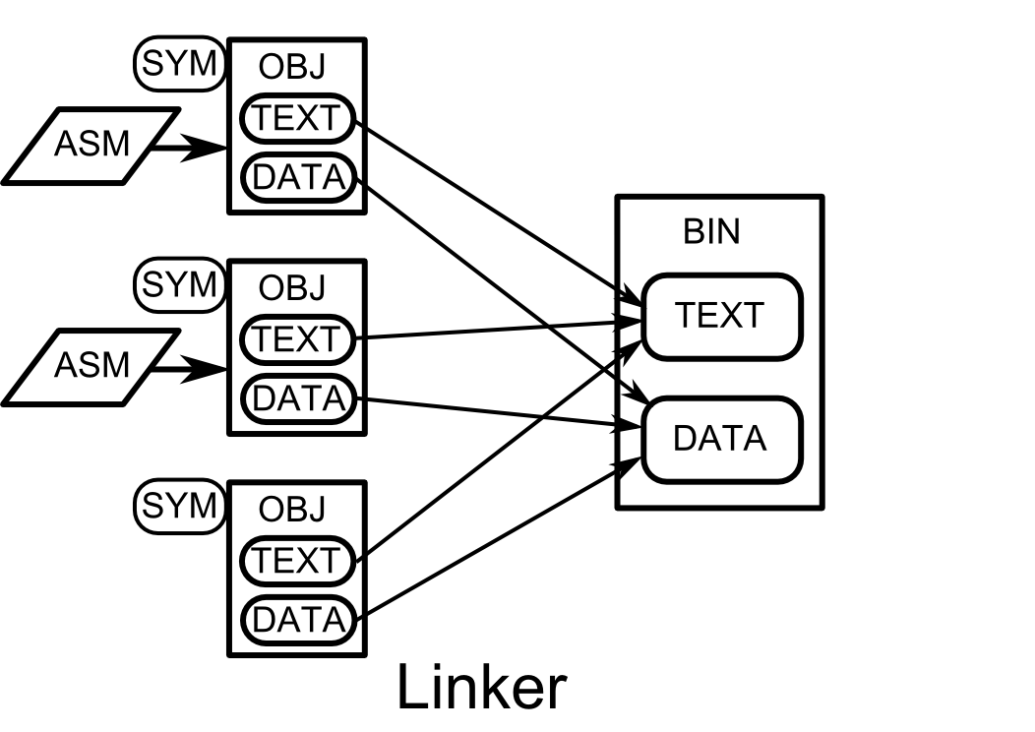
Linking operation

Slide 51
Purpose of loader
Executable may be linked with dynamic libraries
  Symbol resolution cannot occur statically
  Linker called at run-time to resolve dynamic symbols
Loader executed as interpreter of binary
  Specified in .interp section
Relocatable executable also possible
  Maintain relocation information at link time
  Allows address space randomization for code

Slide 52
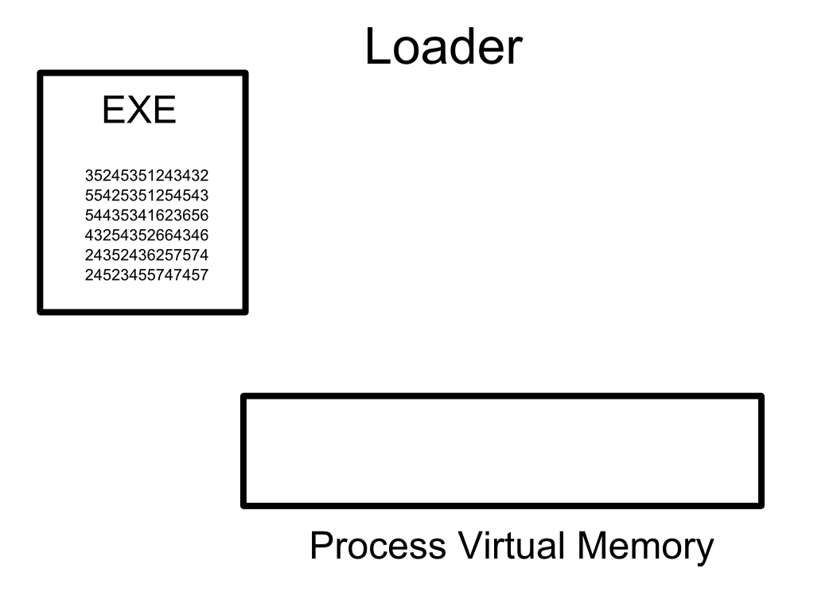
Loading the executable

Slide 53
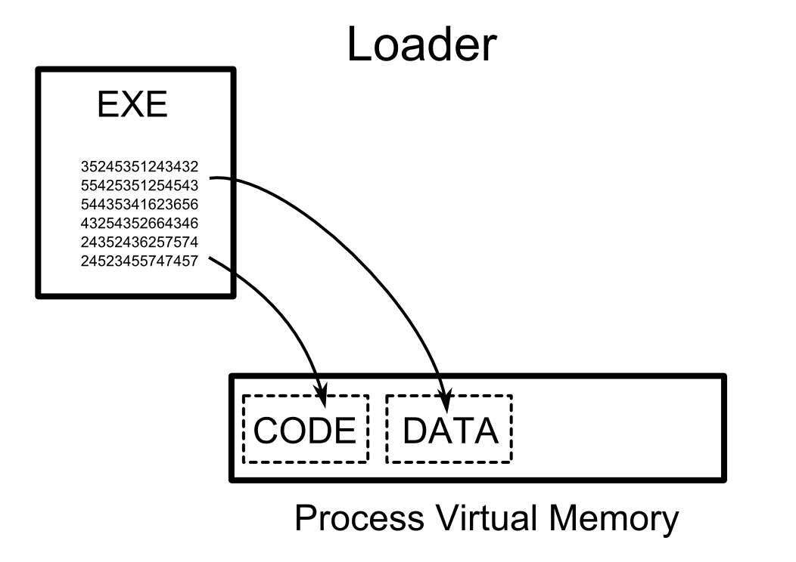
Loading the executable

Slide 54
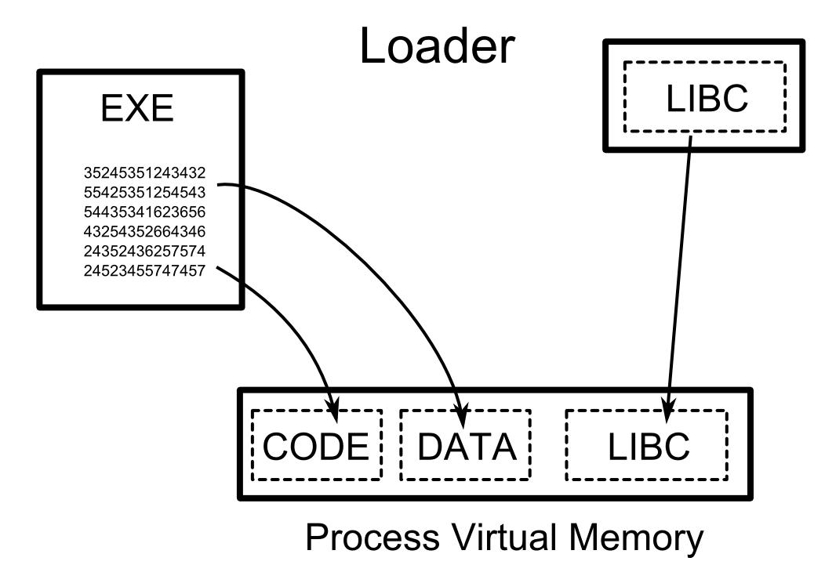
Loading the executable

Slide 55
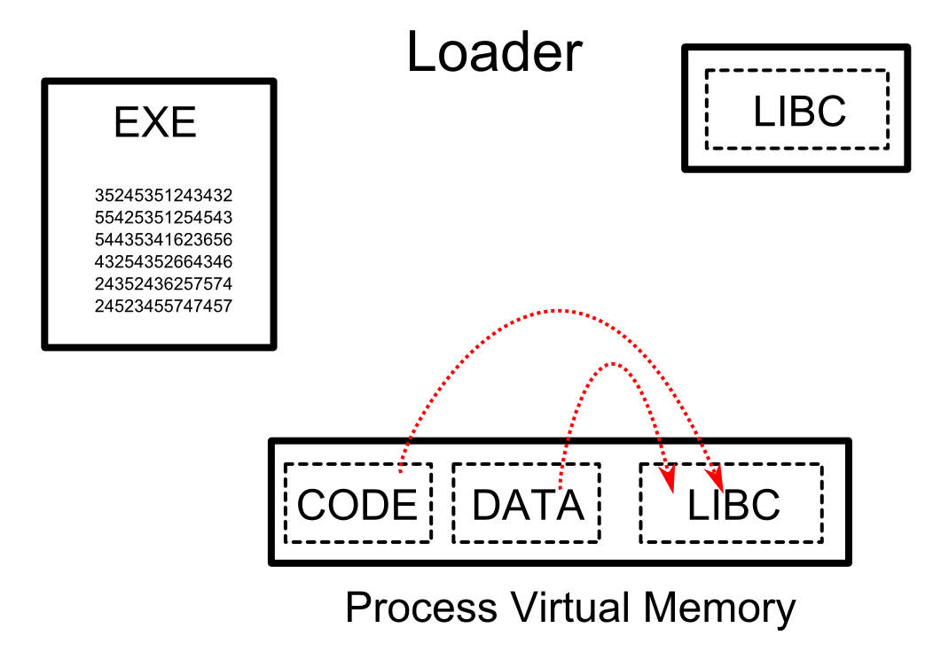
Loading the executable

Slide 56
Minimalistic assembly in Linux
Avoid using libc, focus on what is needed
Execution starts with _start symbol
  Typically libc takes control of it, later calls main
Stack layout:
  ENV pointer, ARGV pointer, ARGC ← Top of Stack
Manual linking of object files for precise control
  GCC automatically adds libc related stuff
  Use: ld asm1.o asm2.o –o a.out
  Minimalistic executable in Linux

Slide 57
System interaction with syscalls
Need to interact with system without libc
Perform raw system calls: set up arguments in registers and perform software interrupt: INT 80h
Calling convention of syscalls (32-bit):
  Syscall number (identifier): EAX
  Arguments: EBX, ECX, EDX, ESI, EDI, EBP
64-bit calling convention: RAX and see lecture 3
Syscall numbers in: asm/unistd.h

