Slide 1
Interacting with X86 hardware devices
by Istvan Haller

Slide 2
Topics to be discussed
Demo: Real-time clock with interrupts
Managing interrupt handlers
Description of the real-time clock
Step-by-step code development
Description of other hardware devices
Keyboard, Timer, Soundcard
Mini-project ideas
Description + overview of development

Slide 3
Demo: Real-time clock with interrupts
Purpose
Learning interrupt handling on real example
Understanding hardware specifications
From online wiki or official programmer’s guide
Writing cool assembly programs
Questions?
What is the real-time clock and how do you use it?
How do I install my interrupt handler?

Slide 4
Installing interrupt handlers
Handlers installed into interrupt descriptor table
IDT contains an entry for every interrupt
CPU accesses IDT indexed on interrupt number
IDT located anywhere in memory
Special CPU register (IDTR) holds info of IDT
Disable interrupts while manipulating IDT!
Disable: CLI; Enable: STI
OSDev IDT info

Slide 5
Manipulating the IDT
Structure of IDTR (on 64bit)
10 bytes long (2 + 8)
Offset 0, Size 2: Maximum offset in IDT (in bytes)
Size of IDT – 1
Offset 2, Size 8: Address of IDT in memory
Reading the value of IDTR: SIDT [address]
Write IDTR using bytes from memory
LIDT [address]

Slide 6
Entry in IDT (64bit architecture)
Each entry is 16 bytes long
Offset 0, Size 2: Address low bits (0..15)
Offset 2, Size 2: Code segment selector
Offset 4, Size 1: Zero
Offset 5, Size 1: Type and Attributes
Offset 6, Size 2: Address middle bits (16..31)
Offset 8, Size 4: Address high bits (32..63)
Offset 12, Size 4: Zero

Slide 7
From request to interrupt
Each hardware device has dedicated IRQ wire
CPU cannot have unlimited input
CPU only interested in interrupt number (vector)
Solution: interrupt controller
Handles individual interrupt requests
Only communicates interrupt number to CPU

Slide 8
Interrupt Controller
Mapping event on physical wire to interrupt
Handling simultaneous events
Why not have dynamic mapping?
Extensibility of hardware devices
Separation between software and hardware design
Programmable Interrupt Controller
Configurable mapping at run-time
Configurable priority levels for interrupts

Slide 9
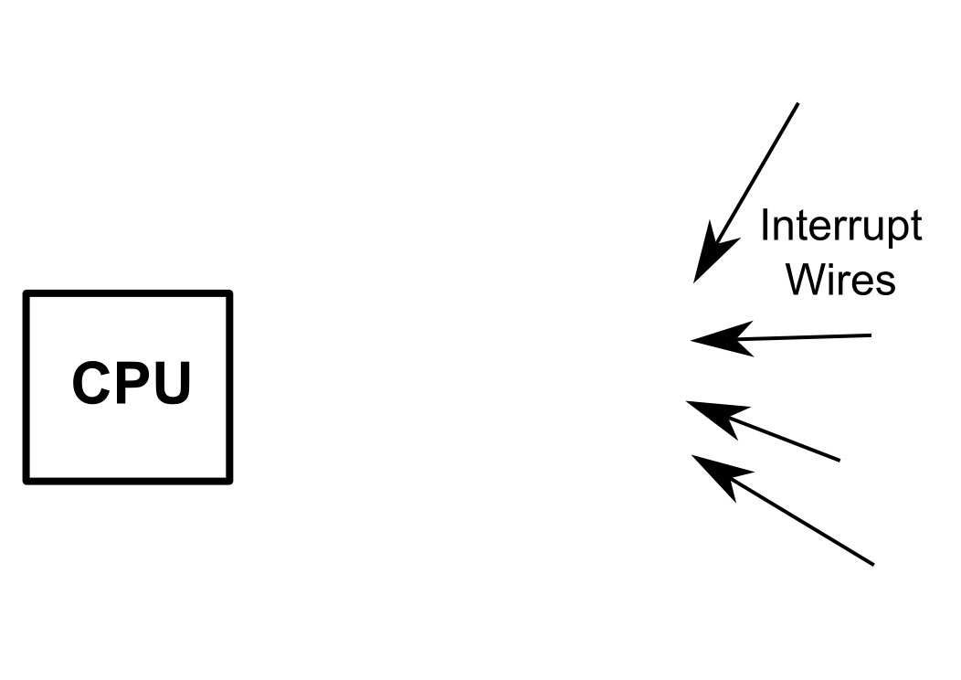
Programmable Interrupt Controller

Slide 10
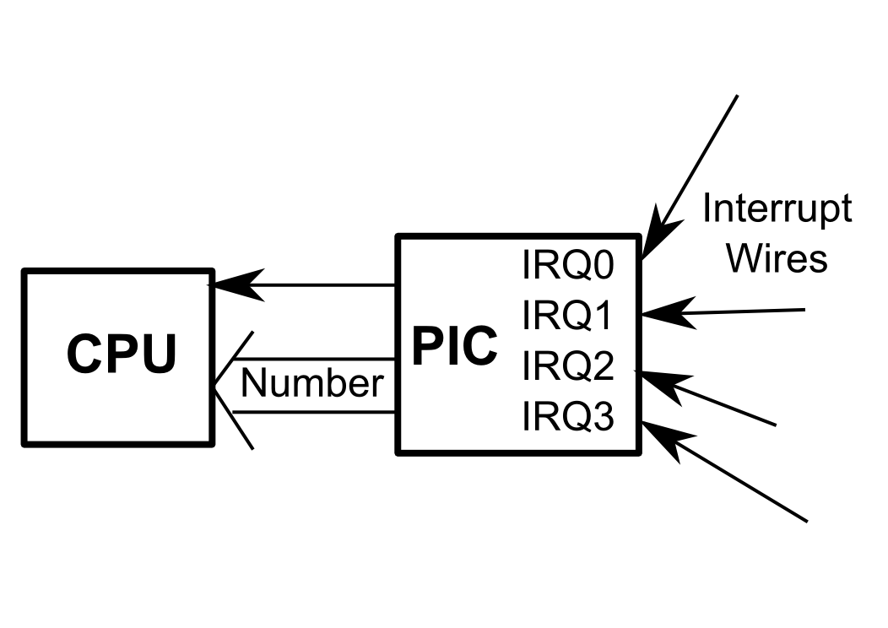
Programmable Interrupt Controller

Slide 11
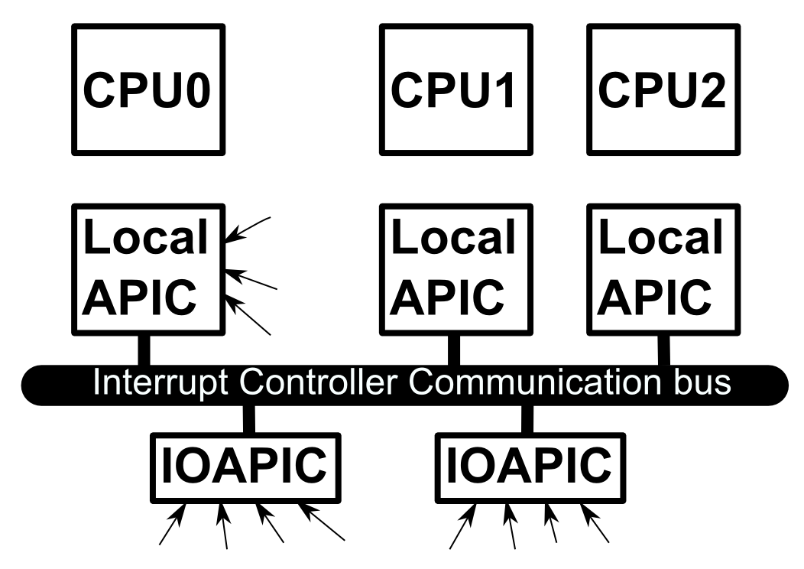
Advanced PIC (APIC) architecture

Slide 12
Demo V1: Software interrupt
Write a custom interrupt handler
Trigger handler using software interrupt
Avoid hardware interaction at first
Baseline:
Write “Hello world!” to the screen after interrupt

Slide 13
V1: Create interrupt handler
Avoid complex processing in handler
Set flag when handler executes
custom_interrupt_handler:
mov byte [FLAG], 1
iretq

Slide 14
V1: Install interrupt handler
Compute address of IDT entry 20 using IDTR
cli ; Disable interrupts
sidt [IDTR] ; Store value of IDTR to memory
lea rbx, [IDTR + 2] ; Select offset from IDTR
mov rbx, [rbx] ; Read offset of IDT into RBX
lea rbx, [rbx + 16 * 20] ; Address of IDT entry 20

Slide 15
V1: Install interrupt handler
Save address of handler in selected entry
lea rax, [custom_interrupt_handler] ; Address
mov [rbx], ax ; Store lower 16 bits
shr rax, 16 ; Store next 16 bits
mov [rbx + 6], ax
shr rax, 16 ; Store remaining 32 bits
mov [rbx + 8], eax
sti ; Enable interrupts

Slide 16
V1: Main loop
Main typically performs background processing
Infinite loop waiting for signal from handler
loop: xor rax, rax ; Check value of FLAG
mov al, [FLAG]
test al, al
jz loop ; Loop while value is 0

Slide 17
V1: Result of trigger
Print “Hello world!” when signal detected
Loop terminates and print called
mov rsi, hello_message ; Load RSI with string call b_print_string ; Print the string

Slide 18
V1: Trigger software interrupt
Needs to occur before infinite loop
Not needed when hardware devices are involved
int 20 ; Trigger interrupt 20

Slide 19
Demo V1: Evaluation
String printed every time
Works even after multiple executions
Everything seems to be perfect

Slide 20
Demo V2: Real-time clock
Use a real hardware event as source of interrupt
Real-time clock also used by OS components
Make sure system is not broken by application
Learn about hardware interaction

Slide 21
Interacting with hardware
Connected with CPU through “ports”
Each includes Control/Status registers
Small piece of storage local to hardware device
Interaction protocol hardware specific
Typically described in data sheet
Few patterns in practice

Slide 22
Reading/Writing hardware ports
Ports accessed though dedicated instructions
IN dst, port_number
OUT port_number, src
For 8-bit ports
port_number: immediate or DX register
src/dst: AL
For 16-bit ports: DX and AX
Some ports are also memory mapped

Slide 23
Real-time clock (RTC)
Low frequency clock chip for keeping time
Operates at 32kHz
Theoretically adjustable, but it affects time-keeping
Secondary frequency provided using divider
2Hz – 32KHz: “real-time” frequencies
frequency = 32768 >> (rate-1);
Secondary frequency generates interrupts (IRQ 8)

Slide 24
Configuring the RTC
2 stage write
Write target register index to port 70h
Read/Write data to target register through port 71h
Status Register A: index Ah
Bit 7: Update in Progress flag, inconsistent date
Bits 6-4: Frequency configuration, don’t modify
Bits 3-0: Rate configuration (1111b: 2Hz, 1110b: 4Hz, ..)
ICH10 Datasheet – page 439
OSDev RTC usage

Slide 25
Additional RTC features
Integrated with CMOS for time/date storage
Runs on battery when system shut down
Ability to retrieve in-depth date information
Seconds/Minutes/Hours
Day/Month/Year
Weekday
Additional status/control information
Status Register B and C
OSDev CMOS info

Slide 26
V2: Interrupt source change
IRQ 8 mapped to entry 28h by kernel
lea rbx, [rbx + 16 * 28h] ; Address of RTC entry
No more software interrupt call

Slide 27
Demo V2: Evaluation
String printed on first execution
System freezes
Virtual LEDs stop blinking
Did RTC stop after first interrupt?
Did we break the OS?
Needs more debugging!

Slide 28
Demo V3: Multiple interrupts
Require multiple handler executions before print
Checks that RTC generates periodic interrupts
Use counter in handler to monitor execution count
Only set flag, when counter reaches 8

Slide 29
V3: New handler
custom_interrupt_handler:
inc byte [COUNT]
cmp byte [COUNT], 8
jne end_custom_interrupt_handler
mov byte [FLAG], 1
end_custom_interrupt_handler:
iretq

Slide 30
Demo V3: Evaluation
String never gets printed
Interrupt handler does not trigger 8 times!
Possibly interrupt occurs a single time!
Reasons?
Detailed hardware specifications (OSDev):
“If register C is not read after an IRQ 8, then the interrupt will not happen again”
“The PIC doesn't send any more interrupts until the cpu acknowledges the interrupt.”

Slide 31
Demo V4: Extended handler
Look into OS code to extend handler
Apply code fragments to custom handler
2 components:
Reading Status Register C of RTC
Acknowledge interrupt on LocalAPIC
LocalAPIC is memory mapped
Address of LocalAPIC is stored in bootloader infomap

Slide 32
V4: Read address of LocalAPIC
Taken from OS code
; Read the address from the Pure64 infomap
mov rsi, 5060h ; Location in infomap
lodsq ; Read quad-word from [rsi] to rax
mov [LOCAL_APIC], rax

Slide 33
V4: Extend end of handler
mov al, 0Ch ; Select RTC register C
out 70h, al ; Port 70h is the RTC index
in al, 71h ; Read the value in register C
; Acknowledge the IRQ
mov rsi, [LOCAL_APIC]
xor eax, eax
mov dword [rsi + 0B0h], eax

Slide 34
Demo V4: Evaluation
String printed to screen
Interrupt triggered multiple times!
Execution freezes when application terminates
Some OS components dependent on RTC?
Further extension of handler counter-intuitive

Slide 35
Demo V5: Chained interrupts
Old interrupt handler contains required code
Old interrupt handler compatible with OS
Chain interrupt handlers
Jump to old handler instead of IRET
Old handler will perform necessary IRET
Jump instead of call ← No reason to return
Similar to “Tail-call” optimization in compilers

Slide 36
V5: Read address of old handler
mov eax, [rbx + 8] ; Load upper 32 bits
shl rax, 32
mov ax, [rbx + 6] ; Load next 16 bits
shl rax, 16
mov ax, [rbx] ; Load remaining 16 bits
mov [ORIGINAL_HANDLER], rax

Slide 37
V5: Chain handlers
custom_interrupt_handler:
inc byte [COUNT]
cmp byte [COUNT], 8
jne end_custom_interrupt_handler
mov byte [FLAG], 1
end_custom_interrupt_handler:
jmp [ORIGINAL_HANDLER]

Slide 38
Demo V5: Evaluation
Works the first time
Virtual LEDs continue to work
Freezes when executed a second time
What happens on second execution?
IDT still points to custom handler
Handler loops to itself

Slide 39
Demo V6: Proper clean-up
Handlers need to be restored before termination
No guarantees about code left in memory
No reason to maintain unneeded handler
Same code as the one writing custom handler

Slide 40
Demo V6: Evaluation
String printed every time
Works even after multiple executions
Everything seems to be perfect

Slide 41
Demo V7: Modularization
Code installing handler written twice in code
Why not encapsulate it in a function?
Which calling convention to use?
Small internal code
Just use some registers
Clearly document custom calling convention!
Be careful about locally used registers!

Slide 42
V7: Function installing handlers
; Installs a new interrupt handler
; RCX interrupt ID (16 bit)
; RAX address of new handler
; RDX memory location to store old handler
install_interrupt_handler:
push rax ; Save rax
…
pop rax ; Restore rax

Slide 43
Demo V8: Custom frequency
What is the current rate of interrupts?
Kernel configures RTC secondary frequency to 8Hz
Can we reconfigure it? Sure!
Write new configuration to Status Register A

Slide 44
V8: Configuring Status Register A
mov al, 0Ah ; Select Status Register A
out 70h, al
in al, 71h ; Read current content
and al, 0F0h ; Preserve upper 4 bits of AL
or al, 1111b ; Set RTC rate to 2Hz
out 71h, al ; Write new content

Slide 45
Demo V8: Evaluation
Everything still works as expected
String printed after a longer time (4 seconds)
Virtual LEDs blink at a slower pace
Even after application terminates
Applications may depend on given frequency
Need to restore frequency before termination

Slide 46
Demo V9: Full clean-up
Ensure that frequency configuration restored
Create function for RTC configuration
Save old configuration to memory
Similar to the interrupt handler clean-up

Slide 47
Demo V9: Evaluation
Everything works as expected
Virtual LEDs blink at a slower paced
Blink speed restored after application finishes
Demo finished!
Conclusions:
Carefully read hardware specification
Think about the different system interactions
Develop applications step-by-step

Slide 48
Other hardware devices: Keyboard
Accessed through PS/2 controller
USB legacy support on motherboard
2 IO Ports: Data and Status/Command
60h: Data (both read and write)
Read mode of 64h: Status
Write mode of 64h: Command
Interrupts generated on IRQ1 (IDT entry 21h)
OSDev PS/2 usage

Slide 49
Other hardware devices: Keyboard
Managing data from keyboard:
Information received in the form of scan-codes
Scan-code represents physical action on keyboard
State managed in software (Shift, Alt, keys held down)
Commands:
Set keyboard LED status
Configure keyboard behavior
OSDev Keyboard usage

Slide 50
Other hardware devices: Timers
Timers are used to measure accurate time delays
Similar to RTC, but finer grained control
Programmable Interval Timer (8253/8254 chip)
Runs at 1.1931816666 MHz
Configurable frequency divider
IRQ0, but APIC not configured in BareMetal
OSDev PIT usage

Slide 51
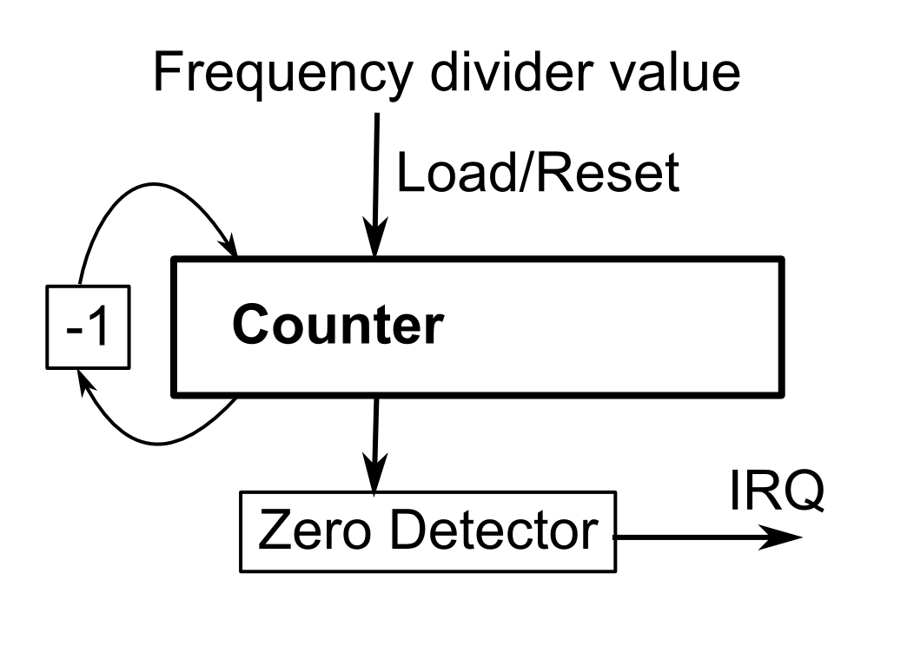
Operating principle of Timers

Slide 52
Other hardware devices: Sound
Different soundcards as PCs evolved
The simplest one to program is SoundBlaster16
Emulation available in QEMU and VirtualBox
General operating principle applies to any card
DSP transforms digital information to analog sound
Manually writing to DSP not preferred
DMA allows automatic transfer
DMA interrupt when transfer finishes

Slide 53
Other hardware devices: Sound
Configuration of SB16 in QEMU
DMA channel 1
DMA IRQ5, but APIC not configured in BareMetal
DSP IO port base address: 220h
Programming the SB16

Slide 54
Mini-projects: Keylogger
Typically first major assembly project
Requires the understanding multiple components
Requirements:
Hook keyboard interrupt to intercept keyboard events
Transform keyboard events into character stream
Save character stream to disk
Keylogger runs in background of other application
Optional: Asynchronous writes to disk

Slide 55
Mini-projects: Keylogger
Executing in background:
No multi-process support in BareMetal
New application reuses memory of old one
Keylogger needs to stay resident in memory
Dynamically allocated memory maybe?
Asynchronous disk writes:
Write to disk in bursts, outside of keyboard interrupt
Writes triggered by timer maybe?

Slide 56
Mini-projects: Morse-code app
Fun and visual project
Transform input characters to Morse-code
Display on keyboard LEDs
Requirements:
Convert keyboard input into Morse-code
Toggle keyboard LEDs based on code
Optional: use timers to simplify blink timing
Optional: hook keyboard interrupts

Slide 57
Mini-projects: Screen Hack
Introduce screen “hacks” on certain triggers
Different character based animations on screen
Falling characters (Matrix style)
Continuously changing characters (color, shape)
Requirements:
Track certain events (keyboard or timer)
Runs in background like keylogger
Manipulates screen buffer in memory

Slide 58
Mini-projects: Classic game
Develop a classic game like Tetris, Snake, …
Learn to develop a raw graphics engine
Learn to program event-based systems
Requirements:
Use keyboard interrupts for input events
Use timers to control game speed
Develop custom graphics engine

Slide 59
Mini-projects: Soundcard driver
Develop a real driver based on hardware specs
Play sound using the emulated SoundBlaster16
Requirements:
Enable the DMA interrupt in the APIC
Configure the DMA controller and the DSP
Convert some audio files to the right format
Optional: Auditory Morse-code
Optional: Play Audio-CD

Slide 60
Mini-projects: Serial port daemon
Build a daemon to access the BareMetal API through the serial port
Control BareMetal from host system
Requirements:
Develop a serial port driver
Develop a custom communication protocol
Develop a daemon that executes received commands

Slide 61
Mini-projects: Multi-tasking
Extend BareMetal with multi-tasking support
Requirements:
Develop per-process virtual memory support
Develop data-structures for process information
Develop support to clone current process (fork)
Reuse current execution mechanism for “exec”
Develop a scheduler using timers (preemption)

