Slide 1
Very Large Cross-lingual Resources at OAEI 2008
Laura Hollink
Véronique Malaisé
Vrije Universiteit Amsterdam

Slide 2
Task description
Mappings between three resources:
  GTAA
    Thesaurus of the Dutch Institute for Sound and Vision.
    4 Facets: Subject, Location, People, Name
  WordNet
    Lexical database
  DBPedia
    ‘structured version of Wikipedia’
3 sets of mappings
exactMatch, broadMatch, narrowMatch.

Slide 3
Rationale
Different languages
  Archive with GTAA metadata in Dutch only
  Broaden user group
  Integrated access to archives of other countries?
Large resources
  Disambiguation becomes serious problem
Heterogeneous resources
  Different structure
  Weak or inconsistent structure
  Large parts have no counterparts, when to stop mapping?

Slide 4
Cross-Lingual
GTAA in Dutch:
  Preferred labels
  Alternative labels
  Scope notes
WordNet in English
  Word-senses
  Glosses
DBPedia in English and (most of the time) Dutch
  Titles
  Abstracts

Slide 5
Different Schema’s
GTAA in SKOS
  Skos:concepts with pref- and altLabels
  Narrower/Broader relations between the concepts
WordNet
  Synsets with word-senses
  Hyponym relations between synsets.
DBPedia
  Things with titles and abstracts
  links to dbpedia categories, rdf:type links to yago classes
  Hierarchical structure of yago classes and categories.

Slide 6
Results
One Participant: DSSIM
Vocabulary | #Concepts | #Mappings to
 | In Vocabulary | WordNet | DBPedia | GTAA
WordNet | 82,000 | NA | 28,974 | 2,405
DBPedia | 2,700,000 | 28,974 | NA | 13,156
GTAA | 160,000 | 2,405 | 13,156 | NA
Subject | 3,800 | 655 | 1,363 | NA
People | 97,000 | 82 | 2,238 | NA
Name | 27,000 | 681 | 3,989 | NA
Location | 14,000 | 987 | 5,566 | NA

Slide 7
Evaluation Process
Precision
  GTAA-WordNet & GTAA-DBPedia
    Inspection of 100 mappings per GTAA facet.
  WordNet-DBPedia
    Inspection of 100 mappings
  Correct or Incorrect or Narrow/Broader/Related
Recall
  GTAA-WordNet & GTAA-DBPedia
    Comparison to a reference alignment of 100 GTAA People and 100 GTAA Subjects

Slide 8
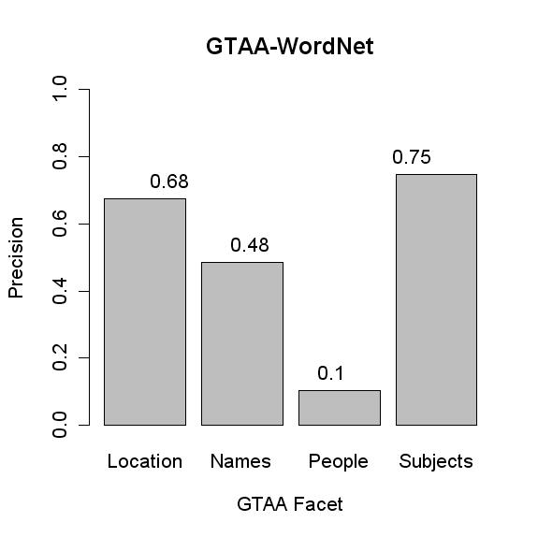

Slide 9
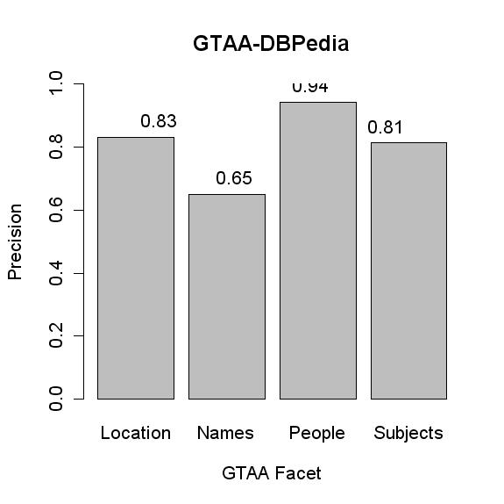

Slide 10
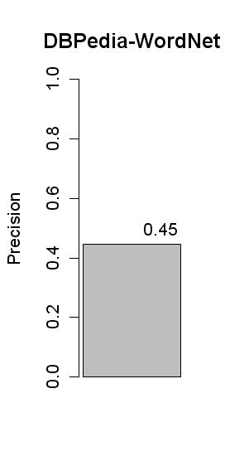

Slide 11
Pre-existing WN-DBPedia Mappings
Type Links
  Air_New_Zealand wordnet-type synset-airline-noun-2
  No overlap between DSSIM mapping and wordnet-type links.
  DSSIM mappings of things with a wordnet-link performed less than DSSIM mappings of things without a wordnet-link.
Yago
  most DBPedia "things" are instances in the YAGO ontology.
  Dbpedia categories are classes in the YAGO ontology, subclasses of wordnet synsets.
  “Crazy”_Joe_Davola rdf:type FictionalCharacter
Overlap between DSSIM results and Yago?
We are looking (mainly) for exactMatches, not type links.

Slide 12
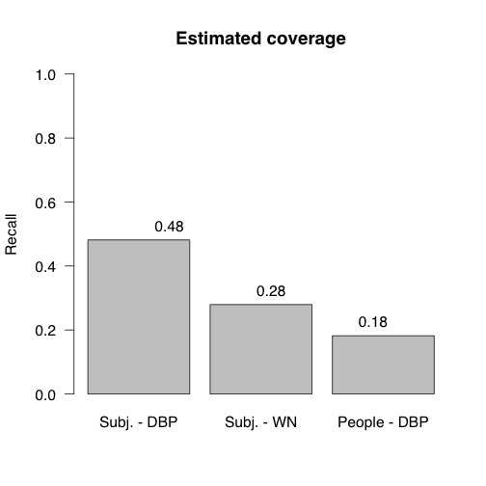

Slide 13
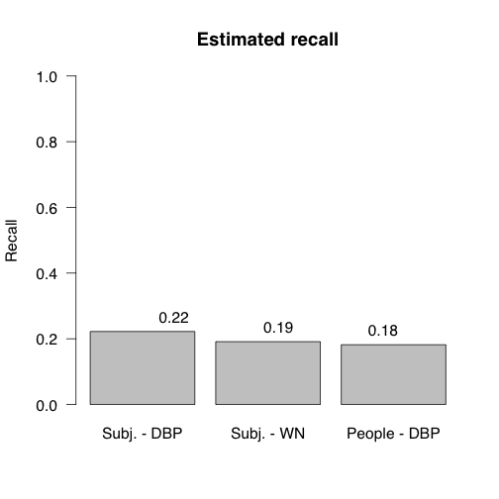

Slide 14
Conclusions
Also other types of links than exactMatch are necessary:
  Subject:pausbezoeken -> List_of_pastoral_visits_of_Pope_John_Paul_II_outside_Italy.
  Location:Venezuela -> synset-Venezuelan-noun-1
  Subject:Verdedigingswerken -> fortification

Slide 15
Conclusions
Context would help a lot.
GTAA facet information <skos:inScheme>
  Person:GoghVincentvan -> synset-vacationing-noun-1
  Location:Harlem -> synset-hammer-noun-8
  Location:Melbourne -> synset-Melbourne-noun-1
Titles of DBPedia ‘referring pages’ used as alternative labels.
    Person:SummerGordon -> Sting_(musician)
But: no longer a generally applicable tool.

Slide 16
Reflection on the evaluation process
Disambiguation of DBPedia/WordNet concepts very hard, also for evaluator.
  Subject:leguanen -> Iguana or Iguanidae?
  Multiple mappings are reasonable.
When is a mapping ‘Related’?
DBPedia disambiguation pages.
GTAA contains may Dutch-specific concepts
  Diogenes = TV program
Take into account the confidence measures

Slide 17
Input from you
What do OAEI participants think of this task?
How can we improve it?

Slide 18
Why Not?
Too much preprocessing required?
The three resources have different schema’s?
Tool was not built for resources that large?
Tool was not built for multi-lingual matching?

Slide 19
Thank you!

